Slide 1

Monitoring Commerce with Prometheus
January 2020

Slide 2


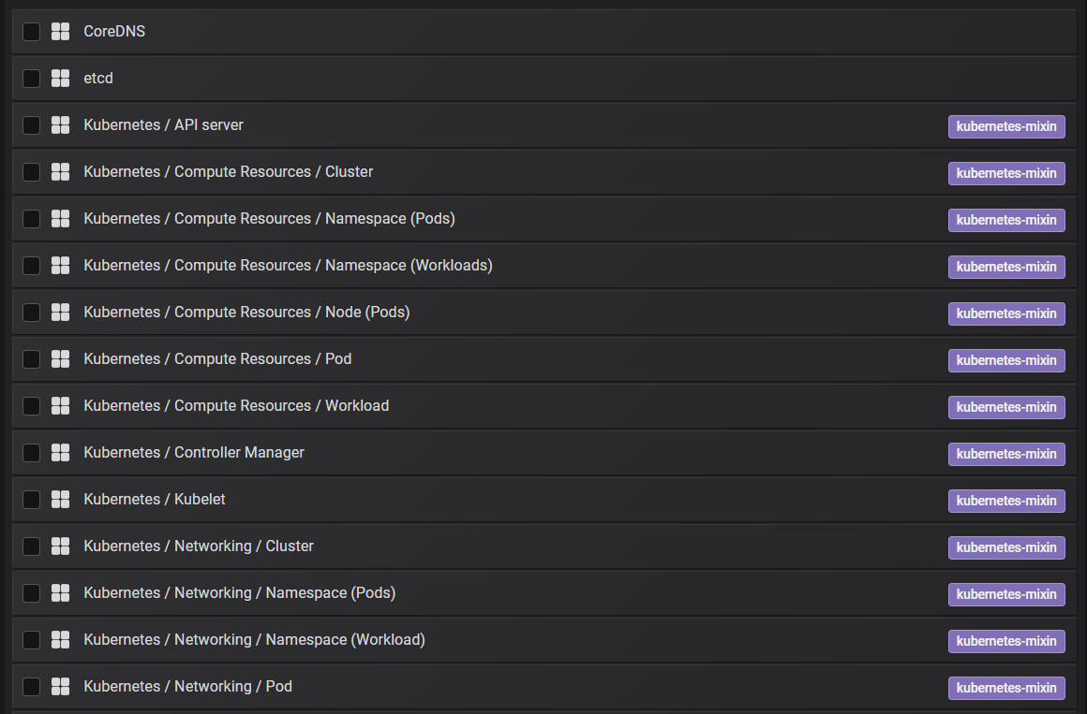
Why Prometheus?
A very popular, Kubernetes friendly monitoring framework
Part of the Cloud Native Computing Foundation
Prometheus is
A Standard metric exposition format
A database to stores metrics
A “scrapping” mechanism
Multiple metrics and Grafana dashboards are installed by default
Microservices frameworks make it easy to export metrics
Helm installs often offer the option to export metrics
Nginx, Kafka, Redis, Solr (exporter)

Slide 3



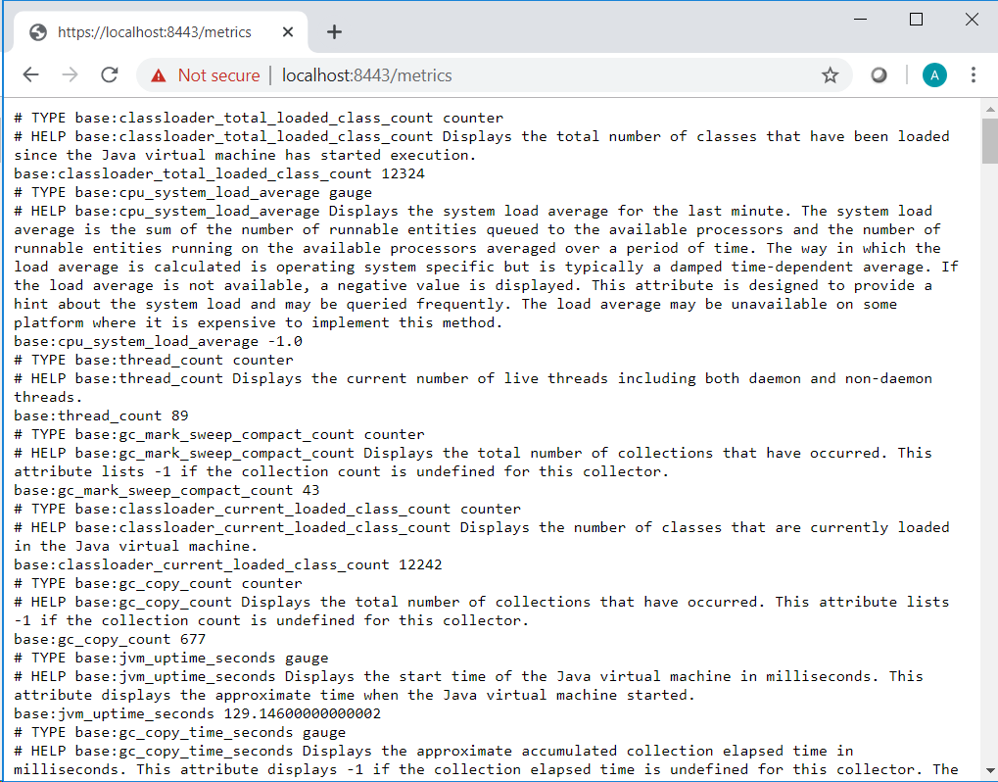



Prometheus Architecture
Grafana
Applications expose metrics on an HTTP endpoint
Prometheus Server and Database
Prometheus console
ServiceMonitor Define metric endpoints and intervals for scrapping
Alert manager
other vendors can consume metrics

Slide 4
Prometheus Metrics
Simple “text based” metric format https://prometheus.io/docs/practices/naming/ name{ label=value label=value}
Prometheus metrics are the base for the OpenMetrics standard that is supported by several vendors
Scrappers automatically add labels to help identify the source: base:thread_count{endpoint="port8080",instance="10.42.0.13:8080",job="demoqalivecrs-app",namespace="commerce",pod="demoqalivecrs-app-5645dbdc9-ctjcf",service="demoqalivecrs-app"}

Slide 5
Prometheus Operator
Prometheus can be installed with helm https://github.com/helm/charts/tree/master/stable/prometheus-operator helm install stable/prometheus-operator -f values.yaml --name prometheus --namespace monitoring --set prometheus.ingress.enabled=true --set grafana.ingress.enabled=true --set prometheus.ingress.hosts[0]=prometheus.local --set grafana.ingress.hosts[0]=grafana.local
This configures the Prometheus database, the Prometheus console (GUI), Grafana, Alert Manager and the service monitors
Persistent volume is required for the database. The easiest option with VMs is to use local-storage (will tie the pod to the node that defined the storage) -- see Local storage and Prometheus-Operator – Helm install with Persistent Volume
After installation you should be able to access Grafana and all the out-of-the-box Kubernetes dashboards
An additional configuration might be required for the service monitor to pick up other applications

Slide 6
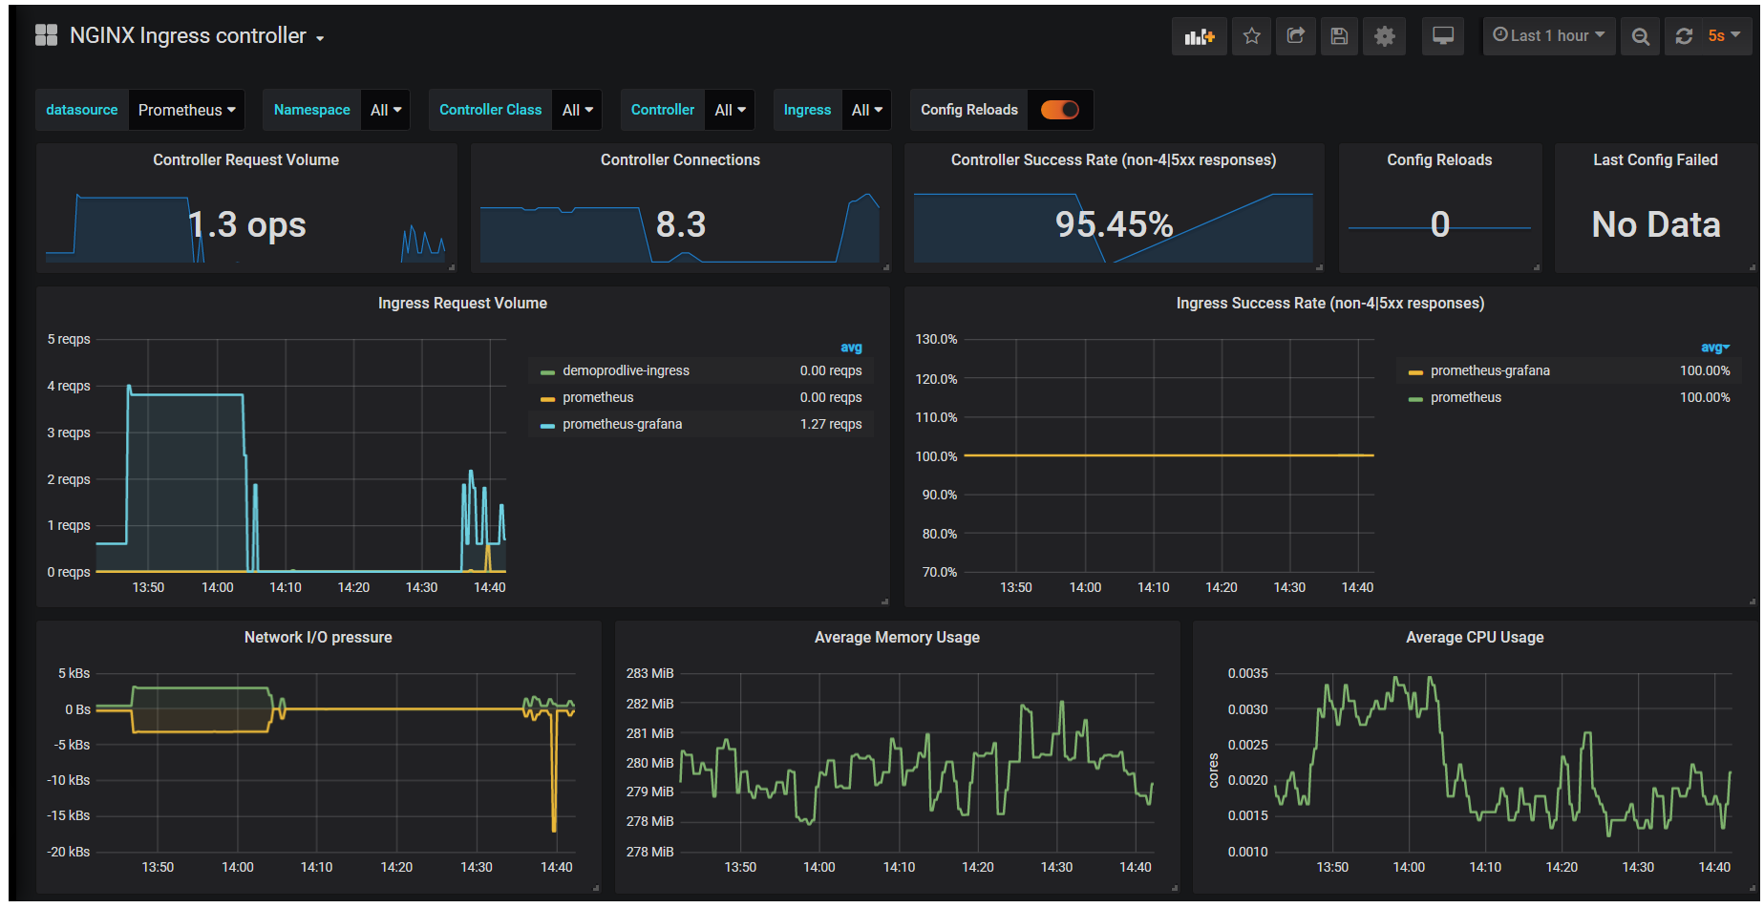
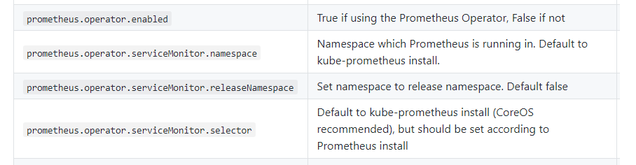
Prometheus with Helm
Many popular helm releases offer Prometheus integration out-of-the-box
Kafka, NGINX, Redis, Solr
Grafana dashboards are made available in GitHub and by the community in Grafana site

Slide 7
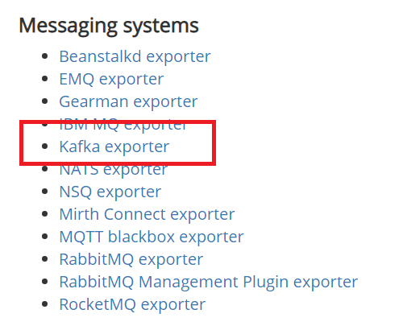
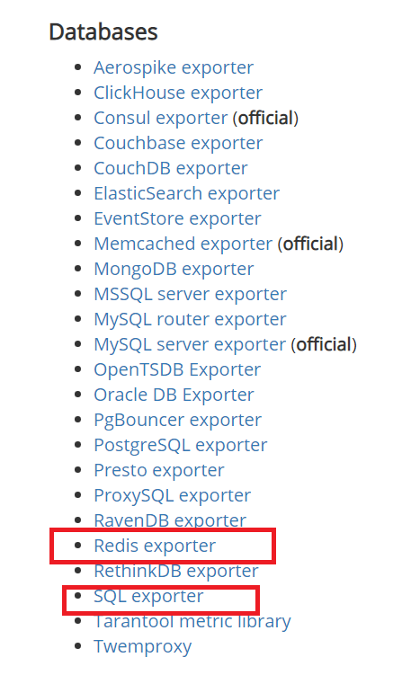
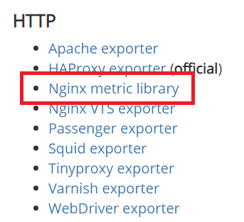
Exporters
When applications don’t support Prometheus natively, exporters can be used to export metrics
A large library of exporters is already available
Applications can create new exporters or extend generic ones ( SQL exporter, JMX Exporter)
https://prometheus.io/docs/instrumenting/exporters/

Slide 8
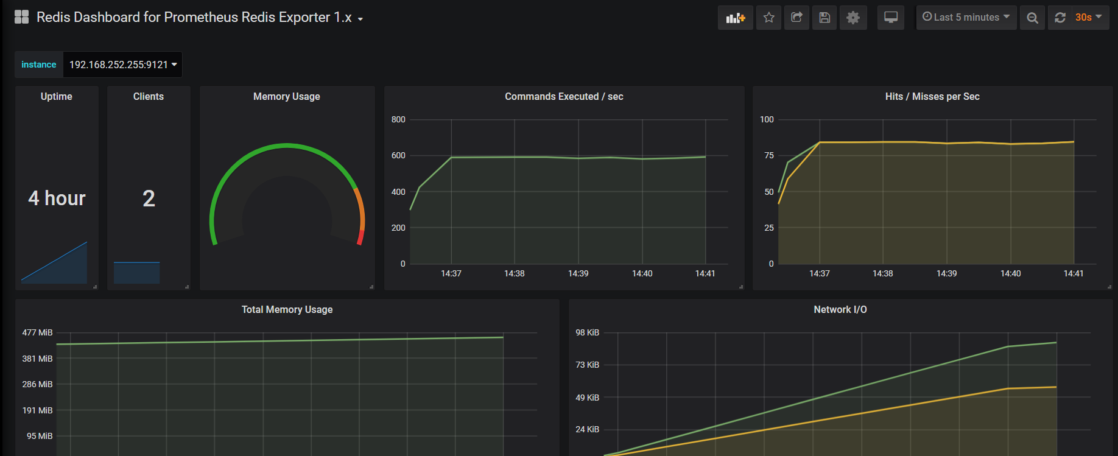
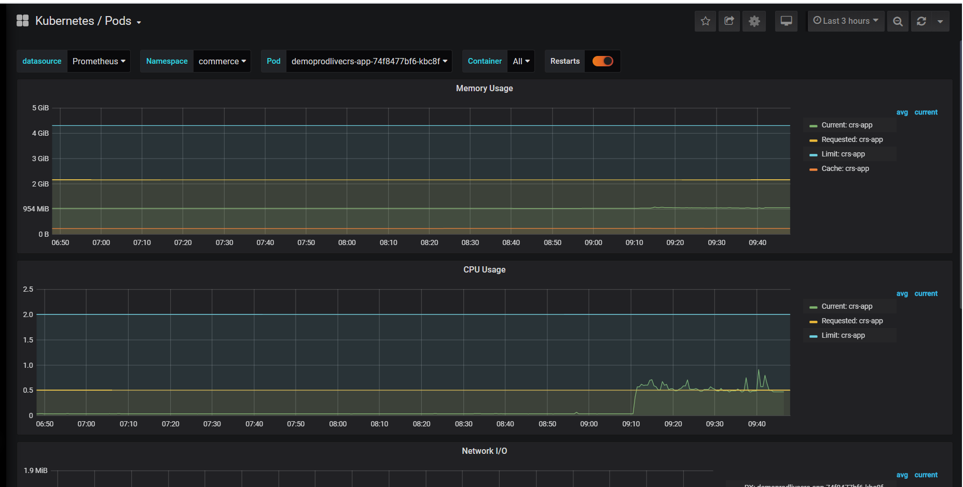
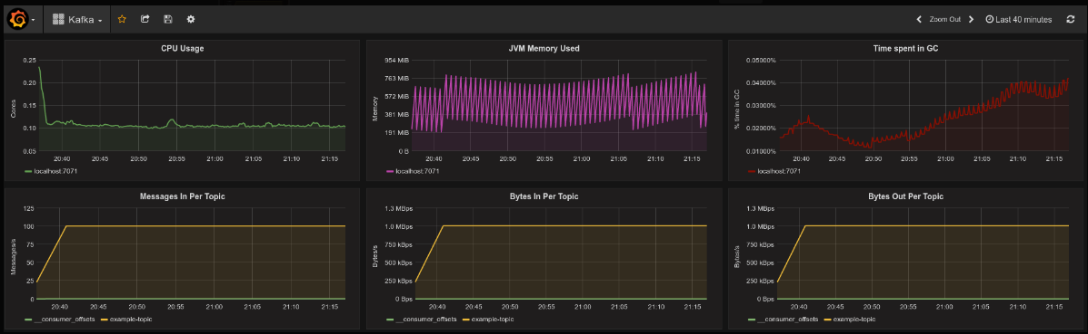
Grafana
Grafana is deployed with Prometheus Operator
It extends Prometheus’ basic charting capabilities
Most applications that support Prometheus, also make Dashboards available
Notes:
https://github.com/kubernetes/ingress-nginx/tree/master/deploy/grafana/dashboards

Slide 9
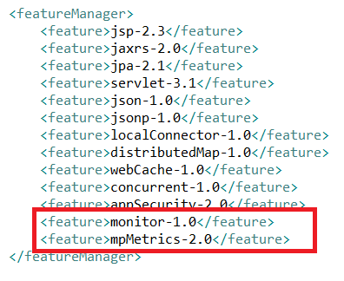
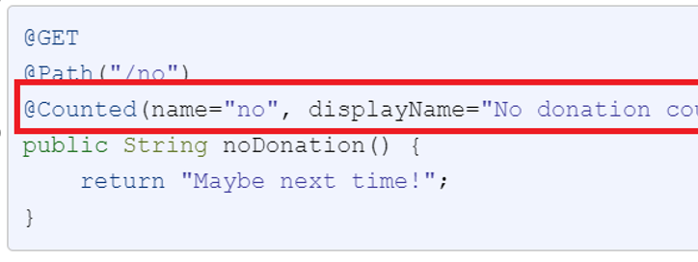
Monitoring Applications
Prometheus operator enables/collects Kubernetes-level metrics
Nodes, Pods, CPU/Memory/Network
To look “inside” an application (e.g. Thread Pool info), the application itself needs to make metrics available
Most modern frameworks ( Liberty/Spring Boot) offer features to define and expose metrics
“Vendor” metrics are added by default
Custom application metrics can be added programmatically and with annotations
Spring Boot: Actuator framework
Liberty: features mpMetrics-1.0, monitor-1.0
Applications can also rely on generic exporters such as JMX Exporters or write their own
Notes:
[kube@comlnx91 ~]$ kubectl port-forward pod/demoprodlivets-app-86f769f4bb-rwnqg -n commerce 18080:18080
Forwarding from 127.0.0.1:18080 -> 18080
Forwarding from [::1]:18080 -> 18080

Slide 10
Monitoring Applications: Kubernetes with Prometheus Operator
The container needs to expose the named-port that publishes the metrics
If the application is external facing, and the same port is used (e.g. 3737) ensure that ingress forbids external access to /metrics
Use port-forward to verify the metrics before completing the configuration: kubectl port-forward demoprodlivesearch-app-slave-687f694c74-cqfsf -n commerce 13737:3737 & curl "http://127.0.0.1:13737/metrics"
Define a service monitor that references the metrics URL
Ensure the service monitor is picked up by Prometheus
Verify serviceMonitorNamespaceSelector and serviceMonitorSelector with this command: kubectl edit prometheus -n monitoring
If picked up, the service monitor will be listed in the Prometheus console ( http://prometheus.local/service-discovery)
Install/Import a Grafana dashboard
apiVersion: monitoring.coreos.com/v1
kind: ServiceMonitor
metadata:
labels:
k8s-apps: http
release: prometheus
name: wc-search-prometheus
namespace: monitoring
spec:
endpoints:
- interval: 15s
path: /metrics
port: port3737
namespaceSelector:
matchNames:
- commerce
selector:
matchLabels:
component: demoprodlivesearch-app-slave
Notes:
https://openliberty.io/docs/ref/general/?_ga=2.198444079.1429278187.1576605819-1814784051.1567616697#microservice_observability_metrics.html
Example of /metrics output
# TYPE base:classloader_total_loaded_class_count counter
# HELP base:classloader_total_loaded_class_count Displays the total number of classes that have been loaded since the Java virtual machine has started execution.
base:classloader_total_loaded_class_count 12324
# TYPE base:cpu_system_load_average gauge
# HELP base:cpu_system_load_average Displays the system load average for the last minute. The system load average is the sum of the number of runnable entities queued to the available processors and the number of runnable entities running on the available processors averaged over a period of time. The way in which the load average is calculated is operating system specific but is typically a damped time-dependent average. If the load average is not available, a negative value is displayed. This attribute is designed to provide a hint about the system load and may be queried frequently. The load average may be unavailable on some platform where it is expensive to implement this method.
base:cpu_system_load_average -1.0
# TYPE base:thread_count counter
# HELP base:thread_count Displays the current number of live threads including both daemon and non-daemon threads.
base:thread_count 89
# TYPE base:gc_mark_sweep_compact_count counter
# HELP base:gc_mark_sweep_compact_count Displays the total number of collections that have occurred. This attribute lists -1 if the collection count is undefined for this collector.
base:gc_mark_sweep_compact_count 43
# TYPE base:classloader_current_loaded_class_count counter
# HELP base:classloader_current_loaded_class_count Displays the number of classes that are currently loaded in the Java virtual machine.
base:classloader_current_loaded_class_count 12242
# TYPE base:gc_copy_count counter
# HELP base:gc_copy_count Displays the total number of collections that have occurred. This attribute lists -1 if the collection count is undefined for this collector.
base:gc_copy_count 677
# TYPE base:jvm_uptime_seconds gauge
# HELP base:jvm_uptime_seconds Displays the start time of the Java virtual machine in milliseconds. This attribute displays the approximate time when the Java virtual machine started.
base:jvm_uptime_seconds 88.15
# TYPE base:gc_copy_time_seconds gauge
# HELP base:gc_copy_time_seconds Displays the approximate accumulated collection elapsed time in milliseconds. This attribute displays -1 if the collection elapsed time is undefined for this collector. The Java virtual machine implementation may use a high resolution timer to measure the elapsed time. This attribute may display the same value even if the collection count has been incremented if the collection elapsed time is very short.
base:gc_copy_time_seconds 1.476
# TYPE base:memory_committed_heap_bytes gauge
# HELP base:memory_committed_heap_bytes Displays the amount of memory in bytes that is committed for the Java virtual machine to use. This amount of memory is guaranteed for the Java virtual machine to use.
base:memory_committed_heap_bytes 3.42556672E8
# TYPE base:thread_max_count counter
# HELP base:thread_max_count Displays the peak live thread count since the Java virtual machine started or peak was reset. This includes daemon and non-daemon threads.
base:thread_max_count 138
# TYPE base:cpu_available_processors gauge
# HELP base:cpu_available_processors Displays the number of processors available to the Java virtual machine. This value may change during a particular invocation of the virtual machine.
base:cpu_available_processors 12
# TYPE base:thread_daemon_count counter
# HELP base:thread_daemon_count Displays the current number of live daemon threads.
base:thread_daemon_count 82
# TYPE base:gc_mark_sweep_compact_time_seconds gauge
# HELP base:gc_mark_sweep_compact_time_seconds Displays the approximate accumulated collection elapsed time in milliseconds. This attribute displays -1 if the collection elapsed time is undefined for this collector. The Java virtual machine implementation may use a high resolution timer to measure the elapsed time. This attribute may display the same value even if the collection count has been incremented if the collection elapsed time is very short.
base:gc_mark_sweep_compact_time_seconds 1.3840000000000001
# TYPE base:classloader_total_unloaded_class_count counter
# HELP base:classloader_total_unloaded_class_count Displays the total number of classes unloaded since the Java virtual machine has started execution.
base:classloader_total_unloaded_class_count 82
# TYPE base:memory_max_heap_bytes gauge
# HELP base:memory_max_heap_bytes Displays the maximum amount of heap memory in bytes that can be used for memory management. This attribute displays -1 if the maximum heap memory size is undefined. This amount of memory is not guaranteed to be available for memory management if it is greater than the amount of committed memory. The Java virtual machine may fail to allocate memory even if the amount of used memory does not exceed this maximum size.
base:memory_max_heap_bytes 5.36870912E8
# TYPE base:cpu_process_cpu_load_percent gauge
# HELP base:cpu_process_cpu_load_percent Displays the 'recent cpu usage' for the Java Virtual Machine process.
base:cpu_process_cpu_load_percent 0.027021240683940892
# TYPE base:memory_used_heap_bytes gauge
# HELP base:memory_used_heap_bytes Displays the amount of used heap memory in bytes.
base:memory_used_heap_bytes 1.78159632E8
# TYPE vendor:servlet_crs_widgets_801_com_ibm_commerce_store_widgets_facet_navigation_facet_navigation_jsp_response_time_total_seconds gauge
# HELP vendor:servlet_crs_widgets_801_com_ibm_commerce_store_widgets_facet_navigation_facet_navigation_jsp_response_time_total_seconds The total response time of this servlet since the start of the server.
vendor:servlet_crs_widgets_801_com_ibm_commerce_store_widgets_facet_navigation_facet_navigation_jsp_response_time_total_seconds 0.016748100000000002
# TYPE vendor:servlet_crs_aurora_storefront_asset_store_widgets_mini_shop_cart_display_mini_shop_cart_display_refresh_jsp_response_time_total_seconds gauge
# HELP vendor:servlet_crs_aurora_storefront_asset_store_widgets_mini_shop_cart_display_mini_shop_cart_display_refresh_jsp_response_time_total_seconds The total response time of this servlet since the start of the server.
vendor:servlet_crs_aurora_storefront_asset_store_widgets_mini_shop_cart_display_mini_shop_cart_display_refresh_jsp_response_time_total_seconds 0.0242548
# TYPE vendor:servlet_crs_stores_request_total counter
# HELP vendor:servlet_crs_stores_request_total The number of visits to this servlet since the start of the server.
vendor:servlet_crs_stores_request_total 4
# TYPE vendor:session_default_host_metrics_live_sessions gauge
# HELP vendor:session_default_host_metrics_live_sessions The number of users that are currently logged in.
vendor:session_default_host_metrics_live_sessions 1
# TYPE vendor:servlet_crs_widgets_801_com_ibm_commerce_store_widgets_content_carousel_content_carousel_jsp_request_total counter
# HELP vendor:servlet_crs_widgets_801_com_ibm_commerce_store_widgets_content_carousel_content_carousel_jsp_request_total The number of visits to this servlet since the start of the server.
vendor:servlet_crs_widgets_801_com_ibm_commerce_store_widgets_content_carousel_content_carousel_jsp_request_total 1
# TYPE vendor:servlet_crs_aurora_storefront_asset_store_shopping_area_catalog_section_category_subsection_category_navigation_display_jsp_response_time_total_seconds gauge
# HELP vendor:servlet_crs_aurora_storefront_asset_store_shopping_area_catalog_section_category_subsection_category_navigation_display_jsp_response_time_total_seconds The total response time of this servlet since the start of the server.
vendor:servlet_crs_aurora_storefront_asset_store_shopping_area_catalog_section_category_subsection_category_navigation_display_jsp_response_time_total_seconds 0.0080234
# TYPE vendor:servlet_crs_widgets_801_com_ibm_commerce_store_widgets_breadcrumb_trail_breadcrumb_trail_hierarchy_jsp_request_total counter
# HELP vendor:servlet_crs_widgets_801_com_ibm_commerce_store_widgets_breadcrumb_trail_breadcrumb_trail_hierarchy_jsp_request_total The number of visits to this servlet since the start of the server.
vendor:servlet_crs_widgets_801_com_ibm_commerce_store_widgets_breadcrumb_trail_breadcrumb_trail_hierarchy_jsp_request_total 1
# TYPE vendor:servlet_crs_aurora_storefront_asset_store_widgets_mini_shop_cart_display_mini_shop_cart_display_refresh_jsp_request_total counter
# HELP vendor:servlet_crs_aurora_storefront_asset_store_widgets_mini_shop_cart_display_mini_shop_cart_display_refresh_jsp_request_total The number of visits to this servlet since the start of the server.
vendor:servlet_crs_aurora_storefront_asset_store_widgets_mini_shop_cart_display_mini_shop_cart_display_refresh_jsp_request_total 2
# TYPE vendor:servlet_crs_store_alias_proxy_file_servlet_request_total counter
# HELP vendor:servlet_crs_store_alias_proxy_file_servlet_request_total The number of visits to this servlet since the start of the server.
vendor:servlet_crs_store_alias_proxy_file_servlet_request_total 39
# TYPE vendor:servlet_crs_aurora_storefront_asset_store_widgets_mini_shop_cart_display_mini_shop_cart_display_jsp_response_time_total_seconds gauge
# HELP vendor:servlet_crs_aurora_storefront_asset_store_widgets_mini_shop_cart_display_mini_shop_cart_display_jsp_response_time_total_seconds The total response time of this servlet since the start of the server.
vendor:servlet_crs_aurora_storefront_asset_store_widgets_mini_shop_cart_display_mini_shop_cart_display_jsp_response_time_total_seconds 0.023008800000000003
# TYPE vendor:servlet_crs_widgets_801_com_ibm_commerce_store_widgets_catalog_entry_recommendation_catalog_entry_recommendation_jsp_request_total counter
# HELP vendor:servlet_crs_widgets_801_com_ibm_commerce_store_widgets_catalog_entry_recommendation_catalog_entry_recommendation_jsp_request_total The number of visits to this servlet since the start of the server.
vendor:servlet_crs_widgets_801_com_ibm_commerce_store_widgets_catalog_entry_recommendation_catalog_entry_recommendation_jsp_request_total 1
# TYPE vendor:servlet_crs_widgets_801_com_ibm_commerce_store_widgets_facet_navigation_facet_navigation_jsp_request_total counter
# HELP vendor:servlet_crs_widgets_801_com_ibm_commerce_store_widgets_facet_navigation_facet_navigation_jsp_request_total The number of visits to this servlet since the start of the server.
vendor:servlet_crs_widgets_801_com_ibm_commerce_store_widgets_facet_navigation_facet_navigation_jsp_request_total 1
# TYPE vendor:servlet_crs_widgets_801_common_catalog_entry_catalog_entry_display_jsp_request_total counter
# HELP vendor:servlet_crs_widgets_801_common_catalog_entry_catalog_entry_display_jsp_request_total The number of visits to this servlet since the start of the server.
vendor:servlet_crs_widgets_801_common_catalog_entry_catalog_entry_display_jsp_request_total 4
# TYPE vendor:session_default_host_metrics_invalidated_total counter
# HELP vendor:session_default_host_metrics_invalidated_total The number of sessions that have logged out since this metric was enabled.
vendor:session_default_host_metrics_invalidated_total 0
# TYPE vendor:servlet_crs_widgets_801_com_ibm_commerce_store_widgets_e_marketing_spot_e_marketing_spot_jsp_response_time_total_seconds gauge
# HELP vendor:servlet_crs_widgets_801_com_ibm_commerce_store_widgets_e_marketing_spot_e_marketing_spot_jsp_response_time_total_seconds The total response time of this servlet since the start of the server.
vendor:servlet_crs_widgets_801_com_ibm_commerce_store_widgets_e_marketing_spot_e_marketing_spot_jsp_response_time_total_seconds 0.22189250000000002
# TYPE vendor:servlet_crs_stores_response_time_total_seconds gauge
# HELP vendor:servlet_crs_stores_response_time_total_seconds The total response time of this servlet since the start of the server.
vendor:servlet_crs_stores_response_time_total_seconds 0.45073280000000004
# TYPE vendor:servlet_crs_aurora_storefront_asset_store_widgets_mini_shop_cart_display_mini_shop_cart_display_jsp_request_total counter
# HELP vendor:servlet_crs_aurora_storefront_asset_store_widgets_mini_shop_cart_display_mini_shop_cart_display_jsp_request_total The number of visits to this servlet since the start of the server.
vendor:servlet_crs_aurora_storefront_asset_store_widgets_mini_shop_cart_display_mini_shop_cart_display_jsp_request_total 2
# TYPE vendor:servlet_crs_widgets_801_com_ibm_commerce_store_widgets_heading_heading_jsp_response_time_total_seconds gauge
# HELP vendor:servlet_crs_widgets_801_com_ibm_commerce_store_widgets_heading_heading_jsp_response_time_total_seconds The total response time of this servlet since the start of the server.
vendor:servlet_crs_widgets_801_com_ibm_commerce_store_widgets_heading_heading_jsp_response_time_total_seconds 0.0057851000000000005
# TYPE vendor:session_default_host_metrics_active_sessions gauge
# HELP vendor:session_default_host_metrics_active_sessions The number of concurrently active sessions. (A session is active if the product is currently processing a request that uses that user session).
vendor:session_default_host_metrics_active_sessions 0
# TYPE vendor:servlet_crs_aurora_storefront_asset_store_shopping_area_catalog_section_category_subsection_category_navigation_display_jsp_request_total counter
# HELP vendor:servlet_crs_aurora_storefront_asset_store_shopping_area_catalog_section_category_subsection_category_navigation_display_jsp_request_total The number of visits to this servlet since the start of the server.
vendor:servlet_crs_aurora_storefront_asset_store_shopping_area_catalog_section_category_subsection_category_navigation_display_jsp_request_total 1
# TYPE vendor:servlet_crs_widgets_801_com_ibm_commerce_store_widgets_category_navigation_category_navigation_jsp_request_total counter
# HELP vendor:servlet_crs_widgets_801_com_ibm_commerce_store_widgets_category_navigation_category_navigation_jsp_request_total The number of visits to this servlet since the start of the server.
vendor:servlet_crs_widgets_801_com_ibm_commerce_store_widgets_category_navigation_category_navigation_jsp_request_total 1
# TYPE vendor:servlet_crs_widgets_801_com_ibm_commerce_store_widgets_content_carousel_content_carousel_jsp_response_time_total_seconds gauge
# HELP vendor:servlet_crs_widgets_801_com_ibm_commerce_store_widgets_content_carousel_content_carousel_jsp_response_time_total_seconds The total response time of this servlet since the start of the server.
vendor:servlet_crs_widgets_801_com_ibm_commerce_store_widgets_content_carousel_content_carousel_jsp_response_time_total_seconds 0.0343139
# TYPE vendor:session_default_host_metrics_invalidatedby_timeout_total counter
# HELP vendor:session_default_host_metrics_invalidatedby_timeout_total The number of sessions that have logged out by timeout since this metric was enabled.
vendor:session_default_host_metrics_invalidatedby_timeout_total 0
# TYPE vendor:servlet_crs_widgets_801_com_ibm_commerce_store_widgets_heading_heading_jsp_request_total counter
# HELP vendor:servlet_crs_widgets_801_com_ibm_commerce_store_widgets_heading_heading_jsp_request_total The number of visits to this servlet since the start of the server.
vendor:servlet_crs_widgets_801_com_ibm_commerce_store_widgets_heading_heading_jsp_request_total 1
# TYPE vendor:servlet_crs_widgets_801_com_ibm_commerce_store_widgets_pdp_add_to_requisition_lists_add_to_requisition_lists_jsp_request_total counter
# HELP vendor:servlet_crs_widgets_801_com_ibm_commerce_store_widgets_pdp_add_to_requisition_lists_add_to_requisition_lists_jsp_request_total The number of visits to this servlet since the start of the server.
vendor:servlet_crs_widgets_801_com_ibm_commerce_store_widgets_pdp_add_to_requisition_lists_add_to_requisition_lists_jsp_request_total 1
# TYPE vendor:threadpool_default_executor_size gauge
# HELP vendor:threadpool_default_executor_size The size of the thread pool.
vendor:threadpool_default_executor_size 36
# TYPE vendor:servlet_crs_aurora_storefront_asset_store_widgets_language_currency_language_currency_jsp_request_total counter
# HELP vendor:servlet_crs_aurora_storefront_asset_store_widgets_language_currency_language_currency_jsp_request_total The number of visits to this servlet since the start of the server.
vendor:servlet_crs_aurora_storefront_asset_store_widgets_language_currency_language_currency_jsp_request_total 2
# TYPE vendor:servlet_crs_aurora_storefront_asset_store_container_home_page_container_jsp_request_total counter
# HELP vendor:servlet_crs_aurora_storefront_asset_store_container_home_page_container_jsp_request_total The number of visits to this servlet since the start of the server.
vendor:servlet_crs_aurora_storefront_asset_store_container_home_page_container_jsp_request_total 1
# TYPE vendor:servlet_crs_aurora_storefront_asset_store_container_top_category_page_container_jsp_response_time_total_seconds gauge
# HELP vendor:servlet_crs_aurora_storefront_asset_store_container_top_category_page_container_jsp_response_time_total_seconds The total response time of this servlet since the start of the server.
vendor:servlet_crs_aurora_storefront_asset_store_container_top_category_page_container_jsp_response_time_total_seconds 0.0086665
# TYPE vendor:servlet_crs_aurora_storefront_asset_store_widgets_header_department_drop_down_jsp_request_total counter
# HELP vendor:servlet_crs_aurora_storefront_asset_store_widgets_header_department_drop_down_jsp_request_total The number of visits to this servlet since the start of the server.
vendor:servlet_crs_aurora_storefront_asset_store_widgets_header_department_drop_down_jsp_request_total 2
# TYPE vendor:servlet_crs_widgets_801_com_ibm_commerce_store_widgets_global_login_global_login_jsp_request_total counter
# HELP vendor:servlet_crs_widgets_801_com_ibm_commerce_store_widgets_global_login_global_login_jsp_request_total The number of visits to this servlet since the start of the server.
vendor:servlet_crs_widgets_801_com_ibm_commerce_store_widgets_global_login_global_login_jsp_request_total 4
# TYPE vendor:servlet_crs_widgets_801_com_ibm_commerce_store_widgets_breadcrumb_trail_breadcrumb_trail_hierarchy_jsp_response_time_total_seconds gauge
# HELP vendor:servlet_crs_widgets_801_com_ibm_commerce_store_widgets_breadcrumb_trail_breadcrumb_trail_hierarchy_jsp_response_time_total_seconds The total response time of this servlet since the start of the server.
vendor:servlet_crs_widgets_801_com_ibm_commerce_store_widgets_breadcrumb_trail_breadcrumb_trail_hierarchy_jsp_response_time_total_seconds 0.3329627
# TYPE vendor:servlet_crs_aurora_storefront_asset_store_widgets_search_search_jsp_response_time_total_seconds gauge
# HELP vendor:servlet_crs_aurora_storefront_asset_store_widgets_search_search_jsp_response_time_total_seconds The total response time of this servlet since the start of the server.
vendor:servlet_crs_aurora_storefront_asset_store_widgets_search_search_jsp_response_time_total_seconds 0.0093197
# TYPE vendor:servlet_crs_aurora_storefront_asset_store_common_call_center_integration_setup_jsp_response_time_total_seconds gauge
# HELP vendor:servlet_crs_aurora_storefront_asset_store_common_call_center_integration_setup_jsp_response_time_total_seconds The total response time of this servlet since the start of the server.
vendor:servlet_crs_aurora_storefront_asset_store_common_call_center_integration_setup_jsp_response_time_total_seconds 0.0186311
# TYPE vendor:servlet_com_ibm_ws_microprofile_metrics_public_public_metrics_rest_proxy_servlet_request_total counter
# HELP vendor:servlet_com_ibm_ws_microprofile_metrics_public_public_metrics_rest_proxy_servlet_request_total The number of visits to this servlet since the start of the server.
vendor:servlet_com_ibm_ws_microprofile_metrics_public_public_metrics_rest_proxy_servlet_request_total 18
# TYPE vendor:servlet_crs_aurora_storefront_asset_store_widgets_footer_footer_jsp_request_total counter
# HELP vendor:servlet_crs_aurora_storefront_asset_store_widgets_footer_footer_jsp_request_total The number of visits to this servlet since the start of the server.
vendor:servlet_crs_aurora_storefront_asset_store_widgets_footer_footer_jsp_request_total 2
# TYPE vendor:servlet_crs_widgets_801_com_ibm_commerce_store_widgets_breadcrumb_trail_breadcrumb_trail_jsp_response_time_total_seconds gauge
# HELP vendor:servlet_crs_widgets_801_com_ibm_commerce_store_widgets_breadcrumb_trail_breadcrumb_trail_jsp_response_time_total_seconds The total response time of this servlet since the start of the server.
vendor:servlet_crs_widgets_801_com_ibm_commerce_store_widgets_breadcrumb_trail_breadcrumb_trail_jsp_response_time_total_seconds 0.333453
# TYPE vendor:servlet_crs_widgets_801_com_ibm_commerce_store_widgets_category_navigation_category_navigation_jsp_response_time_total_seconds gauge
# HELP vendor:servlet_crs_widgets_801_com_ibm_commerce_store_widgets_category_navigation_category_navigation_jsp_response_time_total_seconds The total response time of this servlet since the start of the server.
vendor:servlet_crs_widgets_801_com_ibm_commerce_store_widgets_category_navigation_category_navigation_jsp_response_time_total_seconds 2.0089377
# TYPE vendor:servlet_crs_widgets_801_com_ibm_commerce_store_widgets_catalog_entry_list_catalog_entry_list_jsp_request_total counter
# HELP vendor:servlet_crs_widgets_801_com_ibm_commerce_store_widgets_catalog_entry_list_catalog_entry_list_jsp_request_total The number of visits to this servlet since the start of the server.
vendor:servlet_crs_widgets_801_com_ibm_commerce_store_widgets_catalog_entry_list_catalog_entry_list_jsp_request_total 1
# TYPE vendor:threadpool_default_executor_active_threads gauge
# HELP vendor:threadpool_default_executor_active_threads The number of threads that are running tasks.
vendor:threadpool_default_executor_active_threads 1
# TYPE vendor:servlet_crs_aurora_storefront_asset_store_widgets_language_currency_language_currency_jsp_response_time_total_seconds gauge
# HELP vendor:servlet_crs_aurora_storefront_asset_store_widgets_language_currency_language_currency_jsp_response_time_total_seconds The total response time of this servlet since the start of the server.
vendor:servlet_crs_aurora_storefront_asset_store_widgets_language_currency_language_currency_jsp_response_time_total_seconds 0.028979300000000003
# TYPE vendor:servlet_crs_widgets_801_com_ibm_commerce_store_widgets_category_recommendation_category_recommendation_jsp_request_total counter
# HELP vendor:servlet_crs_widgets_801_com_ibm_commerce_store_widgets_category_recommendation_category_recommendation_jsp_request_total The number of visits to this servlet since the start of the server.
vendor:servlet_crs_widgets_801_com_ibm_commerce_store_widgets_category_recommendation_category_recommendation_jsp_request_total 2
# TYPE vendor:servlet_com_ibm_ws_microprofile_metrics_public_public_metrics_rest_proxy_servlet_response_time_total_seconds gauge
# HELP vendor:servlet_com_ibm_ws_microprofile_metrics_public_public_metrics_rest_proxy_servlet_response_time_total_seconds The total response time of this servlet since the start of the server.
vendor:servlet_com_ibm_ws_microprofile_metrics_public_public_metrics_rest_proxy_servlet_response_time_total_seconds 0.1918744
# TYPE vendor:servlet_crs_widgets_801_com_ibm_commerce_store_widgets_pdp_add_to_requisition_lists_add_to_requisition_lists_jsp_response_time_total_seconds gauge
# HELP vendor:servlet_crs_widgets_801_com_ibm_commerce_store_widgets_pdp_add_to_requisition_lists_add_to_requisition_lists_jsp_response_time_total_seconds The total response time of this servlet since the start of the server.
vendor:servlet_crs_widgets_801_com_ibm_commerce_store_widgets_pdp_add_to_requisition_lists_add_to_requisition_lists_jsp_response_time_total_seconds 0.006526400000000001
# TYPE vendor:servlet_crs_widgets_801_com_ibm_commerce_store_widgets_content_recommendation_content_recommendation_jsp_request_total counter
# HELP vendor:servlet_crs_widgets_801_com_ibm_commerce_store_widgets_content_recommendation_content_recommendation_jsp_request_total The number of visits to this servlet since the start of the server.
vendor:servlet_crs_widgets_801_com_ibm_commerce_store_widgets_content_recommendation_content_recommendation_jsp_request_total 12
# TYPE vendor:servlet_crs_aurora_storefront_asset_store_widgets_search_search_jsp_request_total counter
# HELP vendor:servlet_crs_aurora_storefront_asset_store_widgets_search_search_jsp_request_total The number of visits to this servlet since the start of the server.
vendor:servlet_crs_aurora_storefront_asset_store_widgets_search_search_jsp_request_total 2
# TYPE vendor:servlet_crs_aurora_storefront_asset_store_widgets_header_department_drop_down_jsp_response_time_total_seconds gauge
# HELP vendor:servlet_crs_aurora_storefront_asset_store_widgets_header_department_drop_down_jsp_response_time_total_seconds The total response time of this servlet since the start of the server.
vendor:servlet_crs_aurora_storefront_asset_store_widgets_header_department_drop_down_jsp_response_time_total_seconds 0.2600307
# TYPE vendor:servlet_crs_widgets_801_com_ibm_commerce_store_widgets_global_login_global_login_jsp_response_time_total_seconds gauge
# HELP vendor:servlet_crs_widgets_801_com_ibm_commerce_store_widgets_global_login_global_login_jsp_response_time_total_seconds The total response time of this servlet since the start of the server.
vendor:servlet_crs_widgets_801_com_ibm_commerce_store_widgets_global_login_global_login_jsp_response_time_total_seconds 0.049536100000000007
# TYPE vendor:servlet_crs_widgets_801_com_ibm_commerce_store_widgets_catalog_entry_list_catalog_entry_list_jsp_response_time_total_seconds gauge
# HELP vendor:servlet_crs_widgets_801_com_ibm_commerce_store_widgets_catalog_entry_list_catalog_entry_list_jsp_response_time_total_seconds The total response time of this servlet since the start of the server.
vendor:servlet_crs_widgets_801_com_ibm_commerce_store_widgets_catalog_entry_list_catalog_entry_list_jsp_response_time_total_seconds 0.008221500000000001
# TYPE vendor:servlet_crs_aurora_storefront_asset_store_common_call_center_integration_setup_jsp_request_total counter
# HELP vendor:servlet_crs_aurora_storefront_asset_store_common_call_center_integration_setup_jsp_request_total The number of visits to this servlet since the start of the server.
vendor:servlet_crs_aurora_storefront_asset_store_common_call_center_integration_setup_jsp_request_total 2
# TYPE vendor:servlet_crs_aurora_storefront_asset_store_widgets_header_header_jsp_request_total counter
# HELP vendor:servlet_crs_aurora_storefront_asset_store_widgets_header_header_jsp_request_total The number of visits to this servlet since the start of the server.
vendor:servlet_crs_aurora_storefront_asset_store_widgets_header_header_jsp_request_total 2
# TYPE vendor:servlet_crs_aurora_storefront_asset_store_container_home_page_container_jsp_response_time_total_seconds gauge
# HELP vendor:servlet_crs_aurora_storefront_asset_store_container_home_page_container_jsp_response_time_total_seconds The total response time of this servlet since the start of the server.
vendor:servlet_crs_aurora_storefront_asset_store_container_home_page_container_jsp_response_time_total_seconds 0.010252
# TYPE vendor:servlet_crs_widgets_801_com_ibm_commerce_store_widgets_content_recommendation_content_recommendation_jsp_response_time_total_seconds gauge
# HELP vendor:servlet_crs_widgets_801_com_ibm_commerce_store_widgets_content_recommendation_content_recommendation_jsp_response_time_total_seconds The total response time of this servlet since the start of the server.
vendor:servlet_crs_widgets_801_com_ibm_commerce_store_widgets_content_recommendation_content_recommendation_jsp_response_time_total_seconds 0.165664
# TYPE vendor:servlet_crs_widgets_801_com_ibm_commerce_store_widgets_e_marketing_spot_e_marketing_spot_jsp_request_total counter
# HELP vendor:servlet_crs_widgets_801_com_ibm_commerce_store_widgets_e_marketing_spot_e_marketing_spot_jsp_request_total The number of visits to this servlet since the start of the server.
vendor:servlet_crs_widgets_801_com_ibm_commerce_store_widgets_e_marketing_spot_e_marketing_spot_jsp_request_total 10
# TYPE vendor:servlet_crs_widgets_801_com_ibm_commerce_store_widgets_breadcrumb_trail_breadcrumb_trail_jsp_request_total counter
# HELP vendor:servlet_crs_widgets_801_com_ibm_commerce_store_widgets_breadcrumb_trail_breadcrumb_trail_jsp_request_total The number of visits to this servlet since the start of the server.
vendor:servlet_crs_widgets_801_com_ibm_commerce_store_widgets_breadcrumb_trail_breadcrumb_trail_jsp_request_total 1
# TYPE vendor:servlet_crs_store_alias_proxy_file_servlet_response_time_total_seconds gauge
# HELP vendor:servlet_crs_store_alias_proxy_file_servlet_response_time_total_seconds The total response time of this servlet since the start of the server.
vendor:servlet_crs_store_alias_proxy_file_servlet_response_time_total_seconds 0.35861770000000004
# TYPE vendor:servlet_crs_aurora_storefront_asset_store_shopping_area_catalog_section_category_subsection_top_categories_display_jsp_request_total counter
# HELP vendor:servlet_crs_aurora_storefront_asset_store_shopping_area_catalog_section_category_subsection_top_categories_display_jsp_request_total The number of visits to this servlet since the start of the server.
vendor:servlet_crs_aurora_storefront_asset_store_shopping_area_catalog_section_category_subsection_top_categories_display_jsp_request_total 1
# TYPE vendor:servlet_crs_widgets_801_com_ibm_commerce_store_widgets_category_recommendation_category_recommendation_jsp_response_time_total_seconds gauge
# HELP vendor:servlet_crs_widgets_801_com_ibm_commerce_store_widgets_category_recommendation_category_recommendation_jsp_response_time_total_seconds The total response time of this servlet since the start of the server.
vendor:servlet_crs_widgets_801_com_ibm_commerce_store_widgets_category_recommendation_category_recommendation_jsp_response_time_total_seconds 0.1289789
# TYPE vendor:servlet_crs_aurora_storefront_asset_store_container_top_category_page_container_jsp_request_total counter
# HELP vendor:servlet_crs_aurora_storefront_asset_store_container_top_category_page_container_jsp_request_total The number of visits to this servlet since the start of the server.
vendor:servlet_crs_aurora_storefront_asset_store_container_top_category_page_container_jsp_request_total 1
# TYPE vendor:session_default_host_metrics_create_total gauge
# HELP vendor:session_default_host_metrics_create_total The number of sessions that have logged in since this metric was enabled.
vendor:session_default_host_metrics_create_total 1
# TYPE vendor:servlet_crs_widgets_801_common_catalog_entry_catalog_entry_display_jsp_response_time_total_seconds gauge
# HELP vendor:servlet_crs_widgets_801_common_catalog_entry_catalog_entry_display_jsp_response_time_total_seconds The total response time of this servlet since the start of the server.
vendor:servlet_crs_widgets_801_common_catalog_entry_catalog_entry_display_jsp_response_time_total_seconds 0.1340386
# TYPE vendor:servlet_crs_widgets_801_com_ibm_commerce_store_widgets_catalog_entry_recommendation_catalog_entry_recommendation_jsp_response_time_total_seconds gauge
# HELP vendor:servlet_crs_widgets_801_com_ibm_commerce_store_widgets_catalog_entry_recommendation_catalog_entry_recommendation_jsp_response_time_total_seconds The total response time of this servlet since the start of the server.
vendor:servlet_crs_widgets_801_com_ibm_commerce_store_widgets_catalog_entry_recommendation_catalog_entry_recommendation_jsp_response_time_total_seconds 0.0280912
# TYPE vendor:servlet_crs_aurora_storefront_asset_store_shopping_area_catalog_section_category_subsection_top_categories_display_jsp_response_time_total_seconds gauge
# HELP vendor:servlet_crs_aurora_storefront_asset_store_shopping_area_catalog_section_category_subsection_top_categories_display_jsp_response_time_total_seconds The total response time of this servlet since the start of the server.
vendor:servlet_crs_aurora_storefront_asset_store_shopping_area_catalog_section_category_subsection_top_categories_display_jsp_response_time_total_seconds 0.1803664
# TYPE vendor:servlet_crs_aurora_storefront_asset_store_widgets_header_header_jsp_response_time_total_seconds gauge
# HELP vendor:servlet_crs_aurora_storefront_asset_store_widgets_header_header_jsp_response_time_total_seconds The total response time of this servlet since the start of the server.
vendor:servlet_crs_aurora_storefront_asset_store_widgets_header_header_jsp_response_time_total_seconds 0.011491900000000001
# TYPE vendor:servlet_crs_aurora_storefront_asset_store_widgets_footer_footer_jsp_response_time_total_seconds gauge
# HELP vendor:servlet_crs_aurora_storefront_asset_store_widgets_footer_footer_jsp_response_time_total_seconds The total response time of this servlet since the start of the server.
vendor:servlet_crs_aurora_storefront_asset_store_widgets_footer_footer_jsp_response_time_total_seconds 0.18581630000000002

Slide 11
Integrating Prometheus-style metrics (OpenMetrics) with 3rd party tools
This repository contains a sidecar for the Prometheus server that can send metrics to Stackdriver. https://github.com/Stackdriver/stackdriver-prometheus-sidecar
If you’ve configured your application to expose metrics to a Prometheus backend, you can now send that data to Datadog. Starting with version 6.5.0 of the Datadog Agent, you can use the OpenMetric exposition format to monitor Prometheus metrics alongside all the other data collected by Datadog’s built-in integrations and custom instrumentation libraries. https://www.datadoghq.com/blog/monitor-prometheus-metrics/
The New Relic Prometheus OpenMetrics integration scrapes Prometheus endpoints and sends the data to New Relic. The collected metrics can then be visualized in the Insights UI. https://docs.newrelic.com/docs/integrations/prometheus-integrations/get-started/new-relic-prometheus-openmetrics-integration-kubernetes

Slide 12
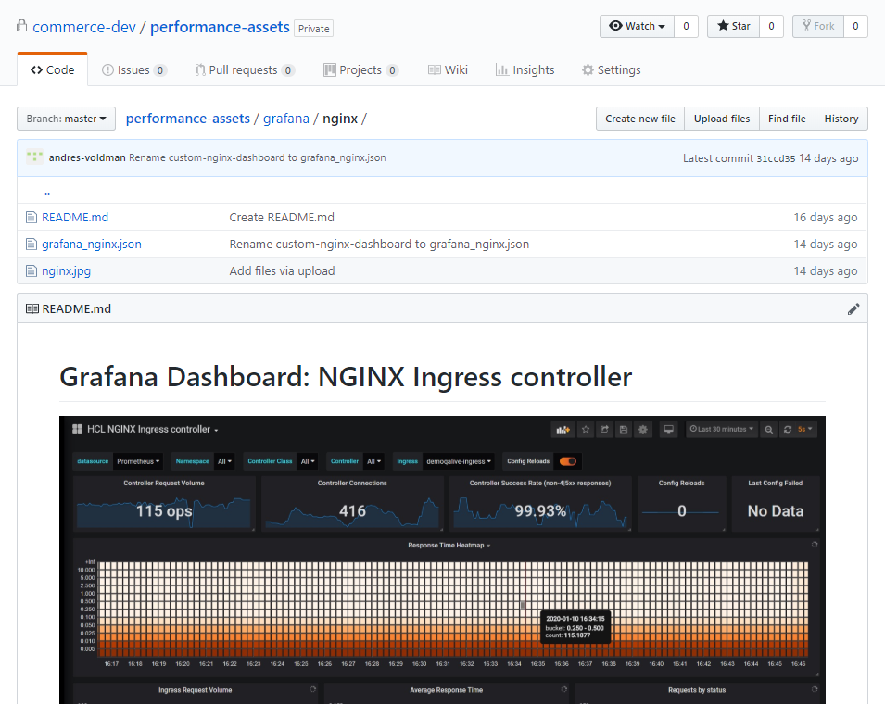
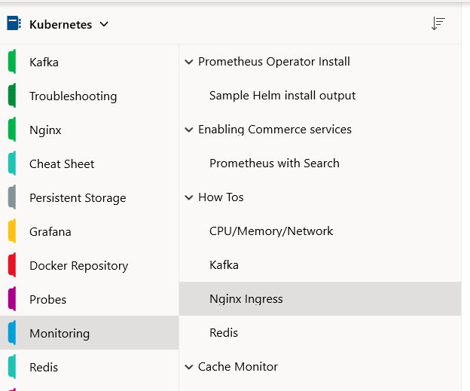
Performance Team: How we plan to monitoring Commerce
Install Prometheus Operator with Kubernetes
Document the dashboards to use for each scenario
Define new dashboards for specific tests
Share dashboards in GitHub
Enable Prometheus metrics in Liberty using Dockerfile
Future: Provide helm option to enable automatically
Continue using New Relic while we still have gaps with Prometheus monitoring
https://github01.hclpnp.com/commerce-dev/performance-assets/tree/master/grafana/nginx
… Work in progress…
Notes:
https://openliberty.io/docs/ref/general/?_ga=2.198444079.1429278187.1576605819-1814784051.1567616697#microservice_observability_metrics.html
Example of /metrics output
# TYPE base:classloader_total_loaded_class_count counter
# HELP base:classloader_total_loaded_class_count Displays the total number of classes that have been loaded since the Java virtual machine has started execution.
base:classloader_total_loaded_class_count 12324
# TYPE base:cpu_system_load_average gauge
# HELP base:cpu_system_load_average Displays the system load average for the last minute. The system load average is the sum of the number of runnable entities queued to the available processors and the number of runnable entities running on the available processors averaged over a period of time. The way in which the load average is calculated is operating system specific but is typically a damped time-dependent average. If the load average is not available, a negative value is displayed. This attribute is designed to provide a hint about the system load and may be queried frequently. The load average may be unavailable on some platform where it is expensive to implement this method.
base:cpu_system_load_average -1.0
# TYPE base:thread_count counter
# HELP base:thread_count Displays the current number of live threads including both daemon and non-daemon threads.
base:thread_count 89
# TYPE base:gc_mark_sweep_compact_count counter
# HELP base:gc_mark_sweep_compact_count Displays the total number of collections that have occurred. This attribute lists -1 if the collection count is undefined for this collector.
base:gc_mark_sweep_compact_count 43
# TYPE base:classloader_current_loaded_class_count counter
# HELP base:classloader_current_loaded_class_count Displays the number of classes that are currently loaded in the Java virtual machine.
base:classloader_current_loaded_class_count 12242
# TYPE base:gc_copy_count counter
# HELP base:gc_copy_count Displays the total number of collections that have occurred. This attribute lists -1 if the collection count is undefined for this collector.
base:gc_copy_count 677
# TYPE base:jvm_uptime_seconds gauge
# HELP base:jvm_uptime_seconds Displays the start time of the Java virtual machine in milliseconds. This attribute displays the approximate time when the Java virtual machine started.
base:jvm_uptime_seconds 88.15
# TYPE base:gc_copy_time_seconds gauge
# HELP base:gc_copy_time_seconds Displays the approximate accumulated collection elapsed time in milliseconds. This attribute displays -1 if the collection elapsed time is undefined for this collector. The Java virtual machine implementation may use a high resolution timer to measure the elapsed time. This attribute may display the same value even if the collection count has been incremented if the collection elapsed time is very short.
base:gc_copy_time_seconds 1.476
# TYPE base:memory_committed_heap_bytes gauge
# HELP base:memory_committed_heap_bytes Displays the amount of memory in bytes that is committed for the Java virtual machine to use. This amount of memory is guaranteed for the Java virtual machine to use.
base:memory_committed_heap_bytes 3.42556672E8
# TYPE base:thread_max_count counter
# HELP base:thread_max_count Displays the peak live thread count since the Java virtual machine started or peak was reset. This includes daemon and non-daemon threads.
base:thread_max_count 138
# TYPE base:cpu_available_processors gauge
# HELP base:cpu_available_processors Displays the number of processors available to the Java virtual machine. This value may change during a particular invocation of the virtual machine.
base:cpu_available_processors 12
# TYPE base:thread_daemon_count counter
# HELP base:thread_daemon_count Displays the current number of live daemon threads.
base:thread_daemon_count 82
# TYPE base:gc_mark_sweep_compact_time_seconds gauge
# HELP base:gc_mark_sweep_compact_time_seconds Displays the approximate accumulated collection elapsed time in milliseconds. This attribute displays -1 if the collection elapsed time is undefined for this collector. The Java virtual machine implementation may use a high resolution timer to measure the elapsed time. This attribute may display the same value even if the collection count has been incremented if the collection elapsed time is very short.
base:gc_mark_sweep_compact_time_seconds 1.3840000000000001
# TYPE base:classloader_total_unloaded_class_count counter
# HELP base:classloader_total_unloaded_class_count Displays the total number of classes unloaded since the Java virtual machine has started execution.
base:classloader_total_unloaded_class_count 82
# TYPE base:memory_max_heap_bytes gauge
# HELP base:memory_max_heap_bytes Displays the maximum amount of heap memory in bytes that can be used for memory management. This attribute displays -1 if the maximum heap memory size is undefined. This amount of memory is not guaranteed to be available for memory management if it is greater than the amount of committed memory. The Java virtual machine may fail to allocate memory even if the amount of used memory does not exceed this maximum size.
base:memory_max_heap_bytes 5.36870912E8
# TYPE base:cpu_process_cpu_load_percent gauge
# HELP base:cpu_process_cpu_load_percent Displays the 'recent cpu usage' for the Java Virtual Machine process.
base:cpu_process_cpu_load_percent 0.027021240683940892
# TYPE base:memory_used_heap_bytes gauge
# HELP base:memory_used_heap_bytes Displays the amount of used heap memory in bytes.
base:memory_used_heap_bytes 1.78159632E8
# TYPE vendor:servlet_crs_widgets_801_com_ibm_commerce_store_widgets_facet_navigation_facet_navigation_jsp_response_time_total_seconds gauge
# HELP vendor:servlet_crs_widgets_801_com_ibm_commerce_store_widgets_facet_navigation_facet_navigation_jsp_response_time_total_seconds The total response time of this servlet since the start of the server.
vendor:servlet_crs_widgets_801_com_ibm_commerce_store_widgets_facet_navigation_facet_navigation_jsp_response_time_total_seconds 0.016748100000000002
# TYPE vendor:servlet_crs_aurora_storefront_asset_store_widgets_mini_shop_cart_display_mini_shop_cart_display_refresh_jsp_response_time_total_seconds gauge
# HELP vendor:servlet_crs_aurora_storefront_asset_store_widgets_mini_shop_cart_display_mini_shop_cart_display_refresh_jsp_response_time_total_seconds The total response time of this servlet since the start of the server.
vendor:servlet_crs_aurora_storefront_asset_store_widgets_mini_shop_cart_display_mini_shop_cart_display_refresh_jsp_response_time_total_seconds 0.0242548
# TYPE vendor:servlet_crs_stores_request_total counter
# HELP vendor:servlet_crs_stores_request_total The number of visits to this servlet since the start of the server.
vendor:servlet_crs_stores_request_total 4
# TYPE vendor:session_default_host_metrics_live_sessions gauge
# HELP vendor:session_default_host_metrics_live_sessions The number of users that are currently logged in.
vendor:session_default_host_metrics_live_sessions 1
# TYPE vendor:servlet_crs_widgets_801_com_ibm_commerce_store_widgets_content_carousel_content_carousel_jsp_request_total counter
# HELP vendor:servlet_crs_widgets_801_com_ibm_commerce_store_widgets_content_carousel_content_carousel_jsp_request_total The number of visits to this servlet since the start of the server.
vendor:servlet_crs_widgets_801_com_ibm_commerce_store_widgets_content_carousel_content_carousel_jsp_request_total 1
# TYPE vendor:servlet_crs_aurora_storefront_asset_store_shopping_area_catalog_section_category_subsection_category_navigation_display_jsp_response_time_total_seconds gauge
# HELP vendor:servlet_crs_aurora_storefront_asset_store_shopping_area_catalog_section_category_subsection_category_navigation_display_jsp_response_time_total_seconds The total response time of this servlet since the start of the server.
vendor:servlet_crs_aurora_storefront_asset_store_shopping_area_catalog_section_category_subsection_category_navigation_display_jsp_response_time_total_seconds 0.0080234
# TYPE vendor:servlet_crs_widgets_801_com_ibm_commerce_store_widgets_breadcrumb_trail_breadcrumb_trail_hierarchy_jsp_request_total counter
# HELP vendor:servlet_crs_widgets_801_com_ibm_commerce_store_widgets_breadcrumb_trail_breadcrumb_trail_hierarchy_jsp_request_total The number of visits to this servlet since the start of the server.
vendor:servlet_crs_widgets_801_com_ibm_commerce_store_widgets_breadcrumb_trail_breadcrumb_trail_hierarchy_jsp_request_total 1
# TYPE vendor:servlet_crs_aurora_storefront_asset_store_widgets_mini_shop_cart_display_mini_shop_cart_display_refresh_jsp_request_total counter
# HELP vendor:servlet_crs_aurora_storefront_asset_store_widgets_mini_shop_cart_display_mini_shop_cart_display_refresh_jsp_request_total The number of visits to this servlet since the start of the server.
vendor:servlet_crs_aurora_storefront_asset_store_widgets_mini_shop_cart_display_mini_shop_cart_display_refresh_jsp_request_total 2
# TYPE vendor:servlet_crs_store_alias_proxy_file_servlet_request_total counter
# HELP vendor:servlet_crs_store_alias_proxy_file_servlet_request_total The number of visits to this servlet since the start of the server.
vendor:servlet_crs_store_alias_proxy_file_servlet_request_total 39
# TYPE vendor:servlet_crs_aurora_storefront_asset_store_widgets_mini_shop_cart_display_mini_shop_cart_display_jsp_response_time_total_seconds gauge
# HELP vendor:servlet_crs_aurora_storefront_asset_store_widgets_mini_shop_cart_display_mini_shop_cart_display_jsp_response_time_total_seconds The total response time of this servlet since the start of the server.
vendor:servlet_crs_aurora_storefront_asset_store_widgets_mini_shop_cart_display_mini_shop_cart_display_jsp_response_time_total_seconds 0.023008800000000003
# TYPE vendor:servlet_crs_widgets_801_com_ibm_commerce_store_widgets_catalog_entry_recommendation_catalog_entry_recommendation_jsp_request_total counter
# HELP vendor:servlet_crs_widgets_801_com_ibm_commerce_store_widgets_catalog_entry_recommendation_catalog_entry_recommendation_jsp_request_total The number of visits to this servlet since the start of the server.
vendor:servlet_crs_widgets_801_com_ibm_commerce_store_widgets_catalog_entry_recommendation_catalog_entry_recommendation_jsp_request_total 1
# TYPE vendor:servlet_crs_widgets_801_com_ibm_commerce_store_widgets_facet_navigation_facet_navigation_jsp_request_total counter
# HELP vendor:servlet_crs_widgets_801_com_ibm_commerce_store_widgets_facet_navigation_facet_navigation_jsp_request_total The number of visits to this servlet since the start of the server.
vendor:servlet_crs_widgets_801_com_ibm_commerce_store_widgets_facet_navigation_facet_navigation_jsp_request_total 1
# TYPE vendor:servlet_crs_widgets_801_common_catalog_entry_catalog_entry_display_jsp_request_total counter
# HELP vendor:servlet_crs_widgets_801_common_catalog_entry_catalog_entry_display_jsp_request_total The number of visits to this servlet since the start of the server.
vendor:servlet_crs_widgets_801_common_catalog_entry_catalog_entry_display_jsp_request_total 4
# TYPE vendor:session_default_host_metrics_invalidated_total counter
# HELP vendor:session_default_host_metrics_invalidated_total The number of sessions that have logged out since this metric was enabled.
vendor:session_default_host_metrics_invalidated_total 0
# TYPE vendor:servlet_crs_widgets_801_com_ibm_commerce_store_widgets_e_marketing_spot_e_marketing_spot_jsp_response_time_total_seconds gauge
# HELP vendor:servlet_crs_widgets_801_com_ibm_commerce_store_widgets_e_marketing_spot_e_marketing_spot_jsp_response_time_total_seconds The total response time of this servlet since the start of the server.
vendor:servlet_crs_widgets_801_com_ibm_commerce_store_widgets_e_marketing_spot_e_marketing_spot_jsp_response_time_total_seconds 0.22189250000000002
# TYPE vendor:servlet_crs_stores_response_time_total_seconds gauge
# HELP vendor:servlet_crs_stores_response_time_total_seconds The total response time of this servlet since the start of the server.
vendor:servlet_crs_stores_response_time_total_seconds 0.45073280000000004
# TYPE vendor:servlet_crs_aurora_storefront_asset_store_widgets_mini_shop_cart_display_mini_shop_cart_display_jsp_request_total counter
# HELP vendor:servlet_crs_aurora_storefront_asset_store_widgets_mini_shop_cart_display_mini_shop_cart_display_jsp_request_total The number of visits to this servlet since the start of the server.
vendor:servlet_crs_aurora_storefront_asset_store_widgets_mini_shop_cart_display_mini_shop_cart_display_jsp_request_total 2
# TYPE vendor:servlet_crs_widgets_801_com_ibm_commerce_store_widgets_heading_heading_jsp_response_time_total_seconds gauge
# HELP vendor:servlet_crs_widgets_801_com_ibm_commerce_store_widgets_heading_heading_jsp_response_time_total_seconds The total response time of this servlet since the start of the server.
vendor:servlet_crs_widgets_801_com_ibm_commerce_store_widgets_heading_heading_jsp_response_time_total_seconds 0.0057851000000000005
# TYPE vendor:session_default_host_metrics_active_sessions gauge
# HELP vendor:session_default_host_metrics_active_sessions The number of concurrently active sessions. (A session is active if the product is currently processing a request that uses that user session).
vendor:session_default_host_metrics_active_sessions 0
# TYPE vendor:servlet_crs_aurora_storefront_asset_store_shopping_area_catalog_section_category_subsection_category_navigation_display_jsp_request_total counter
# HELP vendor:servlet_crs_aurora_storefront_asset_store_shopping_area_catalog_section_category_subsection_category_navigation_display_jsp_request_total The number of visits to this servlet since the start of the server.
vendor:servlet_crs_aurora_storefront_asset_store_shopping_area_catalog_section_category_subsection_category_navigation_display_jsp_request_total 1
# TYPE vendor:servlet_crs_widgets_801_com_ibm_commerce_store_widgets_category_navigation_category_navigation_jsp_request_total counter
# HELP vendor:servlet_crs_widgets_801_com_ibm_commerce_store_widgets_category_navigation_category_navigation_jsp_request_total The number of visits to this servlet since the start of the server.
vendor:servlet_crs_widgets_801_com_ibm_commerce_store_widgets_category_navigation_category_navigation_jsp_request_total 1
# TYPE vendor:servlet_crs_widgets_801_com_ibm_commerce_store_widgets_content_carousel_content_carousel_jsp_response_time_total_seconds gauge
# HELP vendor:servlet_crs_widgets_801_com_ibm_commerce_store_widgets_content_carousel_content_carousel_jsp_response_time_total_seconds The total response time of this servlet since the start of the server.
vendor:servlet_crs_widgets_801_com_ibm_commerce_store_widgets_content_carousel_content_carousel_jsp_response_time_total_seconds 0.0343139
# TYPE vendor:session_default_host_metrics_invalidatedby_timeout_total counter
# HELP vendor:session_default_host_metrics_invalidatedby_timeout_total The number of sessions that have logged out by timeout since this metric was enabled.
vendor:session_default_host_metrics_invalidatedby_timeout_total 0
# TYPE vendor:servlet_crs_widgets_801_com_ibm_commerce_store_widgets_heading_heading_jsp_request_total counter
# HELP vendor:servlet_crs_widgets_801_com_ibm_commerce_store_widgets_heading_heading_jsp_request_total The number of visits to this servlet since the start of the server.
vendor:servlet_crs_widgets_801_com_ibm_commerce_store_widgets_heading_heading_jsp_request_total 1
# TYPE vendor:servlet_crs_widgets_801_com_ibm_commerce_store_widgets_pdp_add_to_requisition_lists_add_to_requisition_lists_jsp_request_total counter
# HELP vendor:servlet_crs_widgets_801_com_ibm_commerce_store_widgets_pdp_add_to_requisition_lists_add_to_requisition_lists_jsp_request_total The number of visits to this servlet since the start of the server.
vendor:servlet_crs_widgets_801_com_ibm_commerce_store_widgets_pdp_add_to_requisition_lists_add_to_requisition_lists_jsp_request_total 1
# TYPE vendor:threadpool_default_executor_size gauge
# HELP vendor:threadpool_default_executor_size The size of the thread pool.
vendor:threadpool_default_executor_size 36
# TYPE vendor:servlet_crs_aurora_storefront_asset_store_widgets_language_currency_language_currency_jsp_request_total counter
# HELP vendor:servlet_crs_aurora_storefront_asset_store_widgets_language_currency_language_currency_jsp_request_total The number of visits to this servlet since the start of the server.
vendor:servlet_crs_aurora_storefront_asset_store_widgets_language_currency_language_currency_jsp_request_total 2
# TYPE vendor:servlet_crs_aurora_storefront_asset_store_container_home_page_container_jsp_request_total counter
# HELP vendor:servlet_crs_aurora_storefront_asset_store_container_home_page_container_jsp_request_total The number of visits to this servlet since the start of the server.
vendor:servlet_crs_aurora_storefront_asset_store_container_home_page_container_jsp_request_total 1
# TYPE vendor:servlet_crs_aurora_storefront_asset_store_container_top_category_page_container_jsp_response_time_total_seconds gauge
# HELP vendor:servlet_crs_aurora_storefront_asset_store_container_top_category_page_container_jsp_response_time_total_seconds The total response time of this servlet since the start of the server.
vendor:servlet_crs_aurora_storefront_asset_store_container_top_category_page_container_jsp_response_time_total_seconds 0.0086665
# TYPE vendor:servlet_crs_aurora_storefront_asset_store_widgets_header_department_drop_down_jsp_request_total counter
# HELP vendor:servlet_crs_aurora_storefront_asset_store_widgets_header_department_drop_down_jsp_request_total The number of visits to this servlet since the start of the server.
vendor:servlet_crs_aurora_storefront_asset_store_widgets_header_department_drop_down_jsp_request_total 2
# TYPE vendor:servlet_crs_widgets_801_com_ibm_commerce_store_widgets_global_login_global_login_jsp_request_total counter
# HELP vendor:servlet_crs_widgets_801_com_ibm_commerce_store_widgets_global_login_global_login_jsp_request_total The number of visits to this servlet since the start of the server.
vendor:servlet_crs_widgets_801_com_ibm_commerce_store_widgets_global_login_global_login_jsp_request_total 4
# TYPE vendor:servlet_crs_widgets_801_com_ibm_commerce_store_widgets_breadcrumb_trail_breadcrumb_trail_hierarchy_jsp_response_time_total_seconds gauge
# HELP vendor:servlet_crs_widgets_801_com_ibm_commerce_store_widgets_breadcrumb_trail_breadcrumb_trail_hierarchy_jsp_response_time_total_seconds The total response time of this servlet since the start of the server.
vendor:servlet_crs_widgets_801_com_ibm_commerce_store_widgets_breadcrumb_trail_breadcrumb_trail_hierarchy_jsp_response_time_total_seconds 0.3329627
# TYPE vendor:servlet_crs_aurora_storefront_asset_store_widgets_search_search_jsp_response_time_total_seconds gauge
# HELP vendor:servlet_crs_aurora_storefront_asset_store_widgets_search_search_jsp_response_time_total_seconds The total response time of this servlet since the start of the server.
vendor:servlet_crs_aurora_storefront_asset_store_widgets_search_search_jsp_response_time_total_seconds 0.0093197
# TYPE vendor:servlet_crs_aurora_storefront_asset_store_common_call_center_integration_setup_jsp_response_time_total_seconds gauge
# HELP vendor:servlet_crs_aurora_storefront_asset_store_common_call_center_integration_setup_jsp_response_time_total_seconds The total response time of this servlet since the start of the server.
vendor:servlet_crs_aurora_storefront_asset_store_common_call_center_integration_setup_jsp_response_time_total_seconds 0.0186311
# TYPE vendor:servlet_com_ibm_ws_microprofile_metrics_public_public_metrics_rest_proxy_servlet_request_total counter
# HELP vendor:servlet_com_ibm_ws_microprofile_metrics_public_public_metrics_rest_proxy_servlet_request_total The number of visits to this servlet since the start of the server.
vendor:servlet_com_ibm_ws_microprofile_metrics_public_public_metrics_rest_proxy_servlet_request_total 18
# TYPE vendor:servlet_crs_aurora_storefront_asset_store_widgets_footer_footer_jsp_request_total counter
# HELP vendor:servlet_crs_aurora_storefront_asset_store_widgets_footer_footer_jsp_request_total The number of visits to this servlet since the start of the server.
vendor:servlet_crs_aurora_storefront_asset_store_widgets_footer_footer_jsp_request_total 2
# TYPE vendor:servlet_crs_widgets_801_com_ibm_commerce_store_widgets_breadcrumb_trail_breadcrumb_trail_jsp_response_time_total_seconds gauge
# HELP vendor:servlet_crs_widgets_801_com_ibm_commerce_store_widgets_breadcrumb_trail_breadcrumb_trail_jsp_response_time_total_seconds The total response time of this servlet since the start of the server.
vendor:servlet_crs_widgets_801_com_ibm_commerce_store_widgets_breadcrumb_trail_breadcrumb_trail_jsp_response_time_total_seconds 0.333453
# TYPE vendor:servlet_crs_widgets_801_com_ibm_commerce_store_widgets_category_navigation_category_navigation_jsp_response_time_total_seconds gauge
# HELP vendor:servlet_crs_widgets_801_com_ibm_commerce_store_widgets_category_navigation_category_navigation_jsp_response_time_total_seconds The total response time of this servlet since the start of the server.
vendor:servlet_crs_widgets_801_com_ibm_commerce_store_widgets_category_navigation_category_navigation_jsp_response_time_total_seconds 2.0089377
# TYPE vendor:servlet_crs_widgets_801_com_ibm_commerce_store_widgets_catalog_entry_list_catalog_entry_list_jsp_request_total counter
# HELP vendor:servlet_crs_widgets_801_com_ibm_commerce_store_widgets_catalog_entry_list_catalog_entry_list_jsp_request_total The number of visits to this servlet since the start of the server.
vendor:servlet_crs_widgets_801_com_ibm_commerce_store_widgets_catalog_entry_list_catalog_entry_list_jsp_request_total 1
# TYPE vendor:threadpool_default_executor_active_threads gauge
# HELP vendor:threadpool_default_executor_active_threads The number of threads that are running tasks.
vendor:threadpool_default_executor_active_threads 1
# TYPE vendor:servlet_crs_aurora_storefront_asset_store_widgets_language_currency_language_currency_jsp_response_time_total_seconds gauge
# HELP vendor:servlet_crs_aurora_storefront_asset_store_widgets_language_currency_language_currency_jsp_response_time_total_seconds The total response time of this servlet since the start of the server.
vendor:servlet_crs_aurora_storefront_asset_store_widgets_language_currency_language_currency_jsp_response_time_total_seconds 0.028979300000000003
# TYPE vendor:servlet_crs_widgets_801_com_ibm_commerce_store_widgets_category_recommendation_category_recommendation_jsp_request_total counter
# HELP vendor:servlet_crs_widgets_801_com_ibm_commerce_store_widgets_category_recommendation_category_recommendation_jsp_request_total The number of visits to this servlet since the start of the server.
vendor:servlet_crs_widgets_801_com_ibm_commerce_store_widgets_category_recommendation_category_recommendation_jsp_request_total 2
# TYPE vendor:servlet_com_ibm_ws_microprofile_metrics_public_public_metrics_rest_proxy_servlet_response_time_total_seconds gauge
# HELP vendor:servlet_com_ibm_ws_microprofile_metrics_public_public_metrics_rest_proxy_servlet_response_time_total_seconds The total response time of this servlet since the start of the server.
vendor:servlet_com_ibm_ws_microprofile_metrics_public_public_metrics_rest_proxy_servlet_response_time_total_seconds 0.1918744
# TYPE vendor:servlet_crs_widgets_801_com_ibm_commerce_store_widgets_pdp_add_to_requisition_lists_add_to_requisition_lists_jsp_response_time_total_seconds gauge
# HELP vendor:servlet_crs_widgets_801_com_ibm_commerce_store_widgets_pdp_add_to_requisition_lists_add_to_requisition_lists_jsp_response_time_total_seconds The total response time of this servlet since the start of the server.
vendor:servlet_crs_widgets_801_com_ibm_commerce_store_widgets_pdp_add_to_requisition_lists_add_to_requisition_lists_jsp_response_time_total_seconds 0.006526400000000001
# TYPE vendor:servlet_crs_widgets_801_com_ibm_commerce_store_widgets_content_recommendation_content_recommendation_jsp_request_total counter
# HELP vendor:servlet_crs_widgets_801_com_ibm_commerce_store_widgets_content_recommendation_content_recommendation_jsp_request_total The number of visits to this servlet since the start of the server.
vendor:servlet_crs_widgets_801_com_ibm_commerce_store_widgets_content_recommendation_content_recommendation_jsp_request_total 12
# TYPE vendor:servlet_crs_aurora_storefront_asset_store_widgets_search_search_jsp_request_total counter
# HELP vendor:servlet_crs_aurora_storefront_asset_store_widgets_search_search_jsp_request_total The number of visits to this servlet since the start of the server.
vendor:servlet_crs_aurora_storefront_asset_store_widgets_search_search_jsp_request_total 2
# TYPE vendor:servlet_crs_aurora_storefront_asset_store_widgets_header_department_drop_down_jsp_response_time_total_seconds gauge
# HELP vendor:servlet_crs_aurora_storefront_asset_store_widgets_header_department_drop_down_jsp_response_time_total_seconds The total response time of this servlet since the start of the server.
vendor:servlet_crs_aurora_storefront_asset_store_widgets_header_department_drop_down_jsp_response_time_total_seconds 0.2600307
# TYPE vendor:servlet_crs_widgets_801_com_ibm_commerce_store_widgets_global_login_global_login_jsp_response_time_total_seconds gauge
# HELP vendor:servlet_crs_widgets_801_com_ibm_commerce_store_widgets_global_login_global_login_jsp_response_time_total_seconds The total response time of this servlet since the start of the server.
vendor:servlet_crs_widgets_801_com_ibm_commerce_store_widgets_global_login_global_login_jsp_response_time_total_seconds 0.049536100000000007
# TYPE vendor:servlet_crs_widgets_801_com_ibm_commerce_store_widgets_catalog_entry_list_catalog_entry_list_jsp_response_time_total_seconds gauge
# HELP vendor:servlet_crs_widgets_801_com_ibm_commerce_store_widgets_catalog_entry_list_catalog_entry_list_jsp_response_time_total_seconds The total response time of this servlet since the start of the server.
vendor:servlet_crs_widgets_801_com_ibm_commerce_store_widgets_catalog_entry_list_catalog_entry_list_jsp_response_time_total_seconds 0.008221500000000001
# TYPE vendor:servlet_crs_aurora_storefront_asset_store_common_call_center_integration_setup_jsp_request_total counter
# HELP vendor:servlet_crs_aurora_storefront_asset_store_common_call_center_integration_setup_jsp_request_total The number of visits to this servlet since the start of the server.
vendor:servlet_crs_aurora_storefront_asset_store_common_call_center_integration_setup_jsp_request_total 2
# TYPE vendor:servlet_crs_aurora_storefront_asset_store_widgets_header_header_jsp_request_total counter
# HELP vendor:servlet_crs_aurora_storefront_asset_store_widgets_header_header_jsp_request_total The number of visits to this servlet since the start of the server.
vendor:servlet_crs_aurora_storefront_asset_store_widgets_header_header_jsp_request_total 2
# TYPE vendor:servlet_crs_aurora_storefront_asset_store_container_home_page_container_jsp_response_time_total_seconds gauge
# HELP vendor:servlet_crs_aurora_storefront_asset_store_container_home_page_container_jsp_response_time_total_seconds The total response time of this servlet since the start of the server.
vendor:servlet_crs_aurora_storefront_asset_store_container_home_page_container_jsp_response_time_total_seconds 0.010252
# TYPE vendor:servlet_crs_widgets_801_com_ibm_commerce_store_widgets_content_recommendation_content_recommendation_jsp_response_time_total_seconds gauge
# HELP vendor:servlet_crs_widgets_801_com_ibm_commerce_store_widgets_content_recommendation_content_recommendation_jsp_response_time_total_seconds The total response time of this servlet since the start of the server.
vendor:servlet_crs_widgets_801_com_ibm_commerce_store_widgets_content_recommendation_content_recommendation_jsp_response_time_total_seconds 0.165664
# TYPE vendor:servlet_crs_widgets_801_com_ibm_commerce_store_widgets_e_marketing_spot_e_marketing_spot_jsp_request_total counter
# HELP vendor:servlet_crs_widgets_801_com_ibm_commerce_store_widgets_e_marketing_spot_e_marketing_spot_jsp_request_total The number of visits to this servlet since the start of the server.
vendor:servlet_crs_widgets_801_com_ibm_commerce_store_widgets_e_marketing_spot_e_marketing_spot_jsp_request_total 10
# TYPE vendor:servlet_crs_widgets_801_com_ibm_commerce_store_widgets_breadcrumb_trail_breadcrumb_trail_jsp_request_total counter
# HELP vendor:servlet_crs_widgets_801_com_ibm_commerce_store_widgets_breadcrumb_trail_breadcrumb_trail_jsp_request_total The number of visits to this servlet since the start of the server.
vendor:servlet_crs_widgets_801_com_ibm_commerce_store_widgets_breadcrumb_trail_breadcrumb_trail_jsp_request_total 1
# TYPE vendor:servlet_crs_store_alias_proxy_file_servlet_response_time_total_seconds gauge
# HELP vendor:servlet_crs_store_alias_proxy_file_servlet_response_time_total_seconds The total response time of this servlet since the start of the server.
vendor:servlet_crs_store_alias_proxy_file_servlet_response_time_total_seconds 0.35861770000000004
# TYPE vendor:servlet_crs_aurora_storefront_asset_store_shopping_area_catalog_section_category_subsection_top_categories_display_jsp_request_total counter
# HELP vendor:servlet_crs_aurora_storefront_asset_store_shopping_area_catalog_section_category_subsection_top_categories_display_jsp_request_total The number of visits to this servlet since the start of the server.
vendor:servlet_crs_aurora_storefront_asset_store_shopping_area_catalog_section_category_subsection_top_categories_display_jsp_request_total 1
# TYPE vendor:servlet_crs_widgets_801_com_ibm_commerce_store_widgets_category_recommendation_category_recommendation_jsp_response_time_total_seconds gauge
# HELP vendor:servlet_crs_widgets_801_com_ibm_commerce_store_widgets_category_recommendation_category_recommendation_jsp_response_time_total_seconds The total response time of this servlet since the start of the server.
vendor:servlet_crs_widgets_801_com_ibm_commerce_store_widgets_category_recommendation_category_recommendation_jsp_response_time_total_seconds 0.1289789
# TYPE vendor:servlet_crs_aurora_storefront_asset_store_container_top_category_page_container_jsp_request_total counter
# HELP vendor:servlet_crs_aurora_storefront_asset_store_container_top_category_page_container_jsp_request_total The number of visits to this servlet since the start of the server.
vendor:servlet_crs_aurora_storefront_asset_store_container_top_category_page_container_jsp_request_total 1
# TYPE vendor:session_default_host_metrics_create_total gauge
# HELP vendor:session_default_host_metrics_create_total The number of sessions that have logged in since this metric was enabled.
vendor:session_default_host_metrics_create_total 1
# TYPE vendor:servlet_crs_widgets_801_common_catalog_entry_catalog_entry_display_jsp_response_time_total_seconds gauge
# HELP vendor:servlet_crs_widgets_801_common_catalog_entry_catalog_entry_display_jsp_response_time_total_seconds The total response time of this servlet since the start of the server.
vendor:servlet_crs_widgets_801_common_catalog_entry_catalog_entry_display_jsp_response_time_total_seconds 0.1340386
# TYPE vendor:servlet_crs_widgets_801_com_ibm_commerce_store_widgets_catalog_entry_recommendation_catalog_entry_recommendation_jsp_response_time_total_seconds gauge
# HELP vendor:servlet_crs_widgets_801_com_ibm_commerce_store_widgets_catalog_entry_recommendation_catalog_entry_recommendation_jsp_response_time_total_seconds The total response time of this servlet since the start of the server.
vendor:servlet_crs_widgets_801_com_ibm_commerce_store_widgets_catalog_entry_recommendation_catalog_entry_recommendation_jsp_response_time_total_seconds 0.0280912
# TYPE vendor:servlet_crs_aurora_storefront_asset_store_shopping_area_catalog_section_category_subsection_top_categories_display_jsp_response_time_total_seconds gauge
# HELP vendor:servlet_crs_aurora_storefront_asset_store_shopping_area_catalog_section_category_subsection_top_categories_display_jsp_response_time_total_seconds The total response time of this servlet since the start of the server.
vendor:servlet_crs_aurora_storefront_asset_store_shopping_area_catalog_section_category_subsection_top_categories_display_jsp_response_time_total_seconds 0.1803664
# TYPE vendor:servlet_crs_aurora_storefront_asset_store_widgets_header_header_jsp_response_time_total_seconds gauge
# HELP vendor:servlet_crs_aurora_storefront_asset_store_widgets_header_header_jsp_response_time_total_seconds The total response time of this servlet since the start of the server.
vendor:servlet_crs_aurora_storefront_asset_store_widgets_header_header_jsp_response_time_total_seconds 0.011491900000000001
# TYPE vendor:servlet_crs_aurora_storefront_asset_store_widgets_footer_footer_jsp_response_time_total_seconds gauge
# HELP vendor:servlet_crs_aurora_storefront_asset_store_widgets_footer_footer_jsp_response_time_total_seconds The total response time of this servlet since the start of the server.
vendor:servlet_crs_aurora_storefront_asset_store_widgets_footer_footer_jsp_response_time_total_seconds 0.18581630000000002

Slide 13
Demo time!
Prometheus console
Nginx Helm install with Prometheus options
Importing Grafana Nginx dashboard
Customizing Nginx dashboard
Average request times
Number of requests by status
Notes:
https://openliberty.io/docs/ref/general/?_ga=2.198444079.1429278187.1576605819-1814784051.1567616697#microservice_observability_metrics.html
Example of /metrics output
# TYPE base:classloader_total_loaded_class_count counter
# HELP base:classloader_total_loaded_class_count Displays the total number of classes that have been loaded since the Java virtual machine has started execution.
base:classloader_total_loaded_class_count 12324
# TYPE base:cpu_system_load_average gauge
# HELP base:cpu_system_load_average Displays the system load average for the last minute. The system load average is the sum of the number of runnable entities queued to the available processors and the number of runnable entities running on the available processors averaged over a period of time. The way in which the load average is calculated is operating system specific but is typically a damped time-dependent average. If the load average is not available, a negative value is displayed. This attribute is designed to provide a hint about the system load and may be queried frequently. The load average may be unavailable on some platform where it is expensive to implement this method.
base:cpu_system_load_average -1.0
# TYPE base:thread_count counter
# HELP base:thread_count Displays the current number of live threads including both daemon and non-daemon threads.
base:thread_count 89
# TYPE base:gc_mark_sweep_compact_count counter
# HELP base:gc_mark_sweep_compact_count Displays the total number of collections that have occurred. This attribute lists -1 if the collection count is undefined for this collector.
base:gc_mark_sweep_compact_count 43
# TYPE base:classloader_current_loaded_class_count counter
# HELP base:classloader_current_loaded_class_count Displays the number of classes that are currently loaded in the Java virtual machine.
base:classloader_current_loaded_class_count 12242
# TYPE base:gc_copy_count counter
# HELP base:gc_copy_count Displays the total number of collections that have occurred. This attribute lists -1 if the collection count is undefined for this collector.
base:gc_copy_count 677
# TYPE base:jvm_uptime_seconds gauge
# HELP base:jvm_uptime_seconds Displays the start time of the Java virtual machine in milliseconds. This attribute displays the approximate time when the Java virtual machine started.
base:jvm_uptime_seconds 88.15
# TYPE base:gc_copy_time_seconds gauge
# HELP base:gc_copy_time_seconds Displays the approximate accumulated collection elapsed time in milliseconds. This attribute displays -1 if the collection elapsed time is undefined for this collector. The Java virtual machine implementation may use a high resolution timer to measure the elapsed time. This attribute may display the same value even if the collection count has been incremented if the collection elapsed time is very short.
base:gc_copy_time_seconds 1.476
# TYPE base:memory_committed_heap_bytes gauge
# HELP base:memory_committed_heap_bytes Displays the amount of memory in bytes that is committed for the Java virtual machine to use. This amount of memory is guaranteed for the Java virtual machine to use.
base:memory_committed_heap_bytes 3.42556672E8
# TYPE base:thread_max_count counter
# HELP base:thread_max_count Displays the peak live thread count since the Java virtual machine started or peak was reset. This includes daemon and non-daemon threads.
base:thread_max_count 138
# TYPE base:cpu_available_processors gauge
# HELP base:cpu_available_processors Displays the number of processors available to the Java virtual machine. This value may change during a particular invocation of the virtual machine.
base:cpu_available_processors 12
# TYPE base:thread_daemon_count counter
# HELP base:thread_daemon_count Displays the current number of live daemon threads.
base:thread_daemon_count 82
# TYPE base:gc_mark_sweep_compact_time_seconds gauge
# HELP base:gc_mark_sweep_compact_time_seconds Displays the approximate accumulated collection elapsed time in milliseconds. This attribute displays -1 if the collection elapsed time is undefined for this collector. The Java virtual machine implementation may use a high resolution timer to measure the elapsed time. This attribute may display the same value even if the collection count has been incremented if the collection elapsed time is very short.
base:gc_mark_sweep_compact_time_seconds 1.3840000000000001
# TYPE base:classloader_total_unloaded_class_count counter
# HELP base:classloader_total_unloaded_class_count Displays the total number of classes unloaded since the Java virtual machine has started execution.
base:classloader_total_unloaded_class_count 82
# TYPE base:memory_max_heap_bytes gauge
# HELP base:memory_max_heap_bytes Displays the maximum amount of heap memory in bytes that can be used for memory management. This attribute displays -1 if the maximum heap memory size is undefined. This amount of memory is not guaranteed to be available for memory management if it is greater than the amount of committed memory. The Java virtual machine may fail to allocate memory even if the amount of used memory does not exceed this maximum size.
base:memory_max_heap_bytes 5.36870912E8
# TYPE base:cpu_process_cpu_load_percent gauge
# HELP base:cpu_process_cpu_load_percent Displays the 'recent cpu usage' for the Java Virtual Machine process.
base:cpu_process_cpu_load_percent 0.027021240683940892
# TYPE base:memory_used_heap_bytes gauge
# HELP base:memory_used_heap_bytes Displays the amount of used heap memory in bytes.
base:memory_used_heap_bytes 1.78159632E8
# TYPE vendor:servlet_crs_widgets_801_com_ibm_commerce_store_widgets_facet_navigation_facet_navigation_jsp_response_time_total_seconds gauge
# HELP vendor:servlet_crs_widgets_801_com_ibm_commerce_store_widgets_facet_navigation_facet_navigation_jsp_response_time_total_seconds The total response time of this servlet since the start of the server.
vendor:servlet_crs_widgets_801_com_ibm_commerce_store_widgets_facet_navigation_facet_navigation_jsp_response_time_total_seconds 0.016748100000000002
# TYPE vendor:servlet_crs_aurora_storefront_asset_store_widgets_mini_shop_cart_display_mini_shop_cart_display_refresh_jsp_response_time_total_seconds gauge
# HELP vendor:servlet_crs_aurora_storefront_asset_store_widgets_mini_shop_cart_display_mini_shop_cart_display_refresh_jsp_response_time_total_seconds The total response time of this servlet since the start of the server.
vendor:servlet_crs_aurora_storefront_asset_store_widgets_mini_shop_cart_display_mini_shop_cart_display_refresh_jsp_response_time_total_seconds 0.0242548
# TYPE vendor:servlet_crs_stores_request_total counter
# HELP vendor:servlet_crs_stores_request_total The number of visits to this servlet since the start of the server.
vendor:servlet_crs_stores_request_total 4
# TYPE vendor:session_default_host_metrics_live_sessions gauge
# HELP vendor:session_default_host_metrics_live_sessions The number of users that are currently logged in.
vendor:session_default_host_metrics_live_sessions 1
# TYPE vendor:servlet_crs_widgets_801_com_ibm_commerce_store_widgets_content_carousel_content_carousel_jsp_request_total counter
# HELP vendor:servlet_crs_widgets_801_com_ibm_commerce_store_widgets_content_carousel_content_carousel_jsp_request_total The number of visits to this servlet since the start of the server.
vendor:servlet_crs_widgets_801_com_ibm_commerce_store_widgets_content_carousel_content_carousel_jsp_request_total 1
# TYPE vendor:servlet_crs_aurora_storefront_asset_store_shopping_area_catalog_section_category_subsection_category_navigation_display_jsp_response_time_total_seconds gauge
# HELP vendor:servlet_crs_aurora_storefront_asset_store_shopping_area_catalog_section_category_subsection_category_navigation_display_jsp_response_time_total_seconds The total response time of this servlet since the start of the server.
vendor:servlet_crs_aurora_storefront_asset_store_shopping_area_catalog_section_category_subsection_category_navigation_display_jsp_response_time_total_seconds 0.0080234
# TYPE vendor:servlet_crs_widgets_801_com_ibm_commerce_store_widgets_breadcrumb_trail_breadcrumb_trail_hierarchy_jsp_request_total counter
# HELP vendor:servlet_crs_widgets_801_com_ibm_commerce_store_widgets_breadcrumb_trail_breadcrumb_trail_hierarchy_jsp_request_total The number of visits to this servlet since the start of the server.
vendor:servlet_crs_widgets_801_com_ibm_commerce_store_widgets_breadcrumb_trail_breadcrumb_trail_hierarchy_jsp_request_total 1
# TYPE vendor:servlet_crs_aurora_storefront_asset_store_widgets_mini_shop_cart_display_mini_shop_cart_display_refresh_jsp_request_total counter
# HELP vendor:servlet_crs_aurora_storefront_asset_store_widgets_mini_shop_cart_display_mini_shop_cart_display_refresh_jsp_request_total The number of visits to this servlet since the start of the server.
vendor:servlet_crs_aurora_storefront_asset_store_widgets_mini_shop_cart_display_mini_shop_cart_display_refresh_jsp_request_total 2
# TYPE vendor:servlet_crs_store_alias_proxy_file_servlet_request_total counter
# HELP vendor:servlet_crs_store_alias_proxy_file_servlet_request_total The number of visits to this servlet since the start of the server.
vendor:servlet_crs_store_alias_proxy_file_servlet_request_total 39
# TYPE vendor:servlet_crs_aurora_storefront_asset_store_widgets_mini_shop_cart_display_mini_shop_cart_display_jsp_response_time_total_seconds gauge
# HELP vendor:servlet_crs_aurora_storefront_asset_store_widgets_mini_shop_cart_display_mini_shop_cart_display_jsp_response_time_total_seconds The total response time of this servlet since the start of the server.
vendor:servlet_crs_aurora_storefront_asset_store_widgets_mini_shop_cart_display_mini_shop_cart_display_jsp_response_time_total_seconds 0.023008800000000003
# TYPE vendor:servlet_crs_widgets_801_com_ibm_commerce_store_widgets_catalog_entry_recommendation_catalog_entry_recommendation_jsp_request_total counter
# HELP vendor:servlet_crs_widgets_801_com_ibm_commerce_store_widgets_catalog_entry_recommendation_catalog_entry_recommendation_jsp_request_total The number of visits to this servlet since the start of the server.
vendor:servlet_crs_widgets_801_com_ibm_commerce_store_widgets_catalog_entry_recommendation_catalog_entry_recommendation_jsp_request_total 1
# TYPE vendor:servlet_crs_widgets_801_com_ibm_commerce_store_widgets_facet_navigation_facet_navigation_jsp_request_total counter
# HELP vendor:servlet_crs_widgets_801_com_ibm_commerce_store_widgets_facet_navigation_facet_navigation_jsp_request_total The number of visits to this servlet since the start of the server.
vendor:servlet_crs_widgets_801_com_ibm_commerce_store_widgets_facet_navigation_facet_navigation_jsp_request_total 1
# TYPE vendor:servlet_crs_widgets_801_common_catalog_entry_catalog_entry_display_jsp_request_total counter
# HELP vendor:servlet_crs_widgets_801_common_catalog_entry_catalog_entry_display_jsp_request_total The number of visits to this servlet since the start of the server.
vendor:servlet_crs_widgets_801_common_catalog_entry_catalog_entry_display_jsp_request_total 4
# TYPE vendor:session_default_host_metrics_invalidated_total counter
# HELP vendor:session_default_host_metrics_invalidated_total The number of sessions that have logged out since this metric was enabled.
vendor:session_default_host_metrics_invalidated_total 0
# TYPE vendor:servlet_crs_widgets_801_com_ibm_commerce_store_widgets_e_marketing_spot_e_marketing_spot_jsp_response_time_total_seconds gauge
# HELP vendor:servlet_crs_widgets_801_com_ibm_commerce_store_widgets_e_marketing_spot_e_marketing_spot_jsp_response_time_total_seconds The total response time of this servlet since the start of the server.
vendor:servlet_crs_widgets_801_com_ibm_commerce_store_widgets_e_marketing_spot_e_marketing_spot_jsp_response_time_total_seconds 0.22189250000000002
# TYPE vendor:servlet_crs_stores_response_time_total_seconds gauge
# HELP vendor:servlet_crs_stores_response_time_total_seconds The total response time of this servlet since the start of the server.
vendor:servlet_crs_stores_response_time_total_seconds 0.45073280000000004
# TYPE vendor:servlet_crs_aurora_storefront_asset_store_widgets_mini_shop_cart_display_mini_shop_cart_display_jsp_request_total counter
# HELP vendor:servlet_crs_aurora_storefront_asset_store_widgets_mini_shop_cart_display_mini_shop_cart_display_jsp_request_total The number of visits to this servlet since the start of the server.
vendor:servlet_crs_aurora_storefront_asset_store_widgets_mini_shop_cart_display_mini_shop_cart_display_jsp_request_total 2
# TYPE vendor:servlet_crs_widgets_801_com_ibm_commerce_store_widgets_heading_heading_jsp_response_time_total_seconds gauge
# HELP vendor:servlet_crs_widgets_801_com_ibm_commerce_store_widgets_heading_heading_jsp_response_time_total_seconds The total response time of this servlet since the start of the server.
vendor:servlet_crs_widgets_801_com_ibm_commerce_store_widgets_heading_heading_jsp_response_time_total_seconds 0.0057851000000000005
# TYPE vendor:session_default_host_metrics_active_sessions gauge
# HELP vendor:session_default_host_metrics_active_sessions The number of concurrently active sessions. (A session is active if the product is currently processing a request that uses that user session).
vendor:session_default_host_metrics_active_sessions 0
# TYPE vendor:servlet_crs_aurora_storefront_asset_store_shopping_area_catalog_section_category_subsection_category_navigation_display_jsp_request_total counter
# HELP vendor:servlet_crs_aurora_storefront_asset_store_shopping_area_catalog_section_category_subsection_category_navigation_display_jsp_request_total The number of visits to this servlet since the start of the server.
vendor:servlet_crs_aurora_storefront_asset_store_shopping_area_catalog_section_category_subsection_category_navigation_display_jsp_request_total 1
# TYPE vendor:servlet_crs_widgets_801_com_ibm_commerce_store_widgets_category_navigation_category_navigation_jsp_request_total counter
# HELP vendor:servlet_crs_widgets_801_com_ibm_commerce_store_widgets_category_navigation_category_navigation_jsp_request_total The number of visits to this servlet since the start of the server.
vendor:servlet_crs_widgets_801_com_ibm_commerce_store_widgets_category_navigation_category_navigation_jsp_request_total 1
# TYPE vendor:servlet_crs_widgets_801_com_ibm_commerce_store_widgets_content_carousel_content_carousel_jsp_response_time_total_seconds gauge
# HELP vendor:servlet_crs_widgets_801_com_ibm_commerce_store_widgets_content_carousel_content_carousel_jsp_response_time_total_seconds The total response time of this servlet since the start of the server.
vendor:servlet_crs_widgets_801_com_ibm_commerce_store_widgets_content_carousel_content_carousel_jsp_response_time_total_seconds 0.0343139
# TYPE vendor:session_default_host_metrics_invalidatedby_timeout_total counter
# HELP vendor:session_default_host_metrics_invalidatedby_timeout_total The number of sessions that have logged out by timeout since this metric was enabled.
vendor:session_default_host_metrics_invalidatedby_timeout_total 0
# TYPE vendor:servlet_crs_widgets_801_com_ibm_commerce_store_widgets_heading_heading_jsp_request_total counter
# HELP vendor:servlet_crs_widgets_801_com_ibm_commerce_store_widgets_heading_heading_jsp_request_total The number of visits to this servlet since the start of the server.
vendor:servlet_crs_widgets_801_com_ibm_commerce_store_widgets_heading_heading_jsp_request_total 1
# TYPE vendor:servlet_crs_widgets_801_com_ibm_commerce_store_widgets_pdp_add_to_requisition_lists_add_to_requisition_lists_jsp_request_total counter
# HELP vendor:servlet_crs_widgets_801_com_ibm_commerce_store_widgets_pdp_add_to_requisition_lists_add_to_requisition_lists_jsp_request_total The number of visits to this servlet since the start of the server.
vendor:servlet_crs_widgets_801_com_ibm_commerce_store_widgets_pdp_add_to_requisition_lists_add_to_requisition_lists_jsp_request_total 1
# TYPE vendor:threadpool_default_executor_size gauge
# HELP vendor:threadpool_default_executor_size The size of the thread pool.
vendor:threadpool_default_executor_size 36
# TYPE vendor:servlet_crs_aurora_storefront_asset_store_widgets_language_currency_language_currency_jsp_request_total counter
# HELP vendor:servlet_crs_aurora_storefront_asset_store_widgets_language_currency_language_currency_jsp_request_total The number of visits to this servlet since the start of the server.
vendor:servlet_crs_aurora_storefront_asset_store_widgets_language_currency_language_currency_jsp_request_total 2
# TYPE vendor:servlet_crs_aurora_storefront_asset_store_container_home_page_container_jsp_request_total counter
# HELP vendor:servlet_crs_aurora_storefront_asset_store_container_home_page_container_jsp_request_total The number of visits to this servlet since the start of the server.
vendor:servlet_crs_aurora_storefront_asset_store_container_home_page_container_jsp_request_total 1
# TYPE vendor:servlet_crs_aurora_storefront_asset_store_container_top_category_page_container_jsp_response_time_total_seconds gauge
# HELP vendor:servlet_crs_aurora_storefront_asset_store_container_top_category_page_container_jsp_response_time_total_seconds The total response time of this servlet since the start of the server.
vendor:servlet_crs_aurora_storefront_asset_store_container_top_category_page_container_jsp_response_time_total_seconds 0.0086665
# TYPE vendor:servlet_crs_aurora_storefront_asset_store_widgets_header_department_drop_down_jsp_request_total counter
# HELP vendor:servlet_crs_aurora_storefront_asset_store_widgets_header_department_drop_down_jsp_request_total The number of visits to this servlet since the start of the server.
vendor:servlet_crs_aurora_storefront_asset_store_widgets_header_department_drop_down_jsp_request_total 2
# TYPE vendor:servlet_crs_widgets_801_com_ibm_commerce_store_widgets_global_login_global_login_jsp_request_total counter
# HELP vendor:servlet_crs_widgets_801_com_ibm_commerce_store_widgets_global_login_global_login_jsp_request_total The number of visits to this servlet since the start of the server.
vendor:servlet_crs_widgets_801_com_ibm_commerce_store_widgets_global_login_global_login_jsp_request_total 4
# TYPE vendor:servlet_crs_widgets_801_com_ibm_commerce_store_widgets_breadcrumb_trail_breadcrumb_trail_hierarchy_jsp_response_time_total_seconds gauge
# HELP vendor:servlet_crs_widgets_801_com_ibm_commerce_store_widgets_breadcrumb_trail_breadcrumb_trail_hierarchy_jsp_response_time_total_seconds The total response time of this servlet since the start of the server.
vendor:servlet_crs_widgets_801_com_ibm_commerce_store_widgets_breadcrumb_trail_breadcrumb_trail_hierarchy_jsp_response_time_total_seconds 0.3329627
# TYPE vendor:servlet_crs_aurora_storefront_asset_store_widgets_search_search_jsp_response_time_total_seconds gauge
# HELP vendor:servlet_crs_aurora_storefront_asset_store_widgets_search_search_jsp_response_time_total_seconds The total response time of this servlet since the start of the server.
vendor:servlet_crs_aurora_storefront_asset_store_widgets_search_search_jsp_response_time_total_seconds 0.0093197
# TYPE vendor:servlet_crs_aurora_storefront_asset_store_common_call_center_integration_setup_jsp_response_time_total_seconds gauge
# HELP vendor:servlet_crs_aurora_storefront_asset_store_common_call_center_integration_setup_jsp_response_time_total_seconds The total response time of this servlet since the start of the server.
vendor:servlet_crs_aurora_storefront_asset_store_common_call_center_integration_setup_jsp_response_time_total_seconds 0.0186311
# TYPE vendor:servlet_com_ibm_ws_microprofile_metrics_public_public_metrics_rest_proxy_servlet_request_total counter
# HELP vendor:servlet_com_ibm_ws_microprofile_metrics_public_public_metrics_rest_proxy_servlet_request_total The number of visits to this servlet since the start of the server.
vendor:servlet_com_ibm_ws_microprofile_metrics_public_public_metrics_rest_proxy_servlet_request_total 18
# TYPE vendor:servlet_crs_aurora_storefront_asset_store_widgets_footer_footer_jsp_request_total counter
# HELP vendor:servlet_crs_aurora_storefront_asset_store_widgets_footer_footer_jsp_request_total The number of visits to this servlet since the start of the server.
vendor:servlet_crs_aurora_storefront_asset_store_widgets_footer_footer_jsp_request_total 2
# TYPE vendor:servlet_crs_widgets_801_com_ibm_commerce_store_widgets_breadcrumb_trail_breadcrumb_trail_jsp_response_time_total_seconds gauge
# HELP vendor:servlet_crs_widgets_801_com_ibm_commerce_store_widgets_breadcrumb_trail_breadcrumb_trail_jsp_response_time_total_seconds The total response time of this servlet since the start of the server.
vendor:servlet_crs_widgets_801_com_ibm_commerce_store_widgets_breadcrumb_trail_breadcrumb_trail_jsp_response_time_total_seconds 0.333453
# TYPE vendor:servlet_crs_widgets_801_com_ibm_commerce_store_widgets_category_navigation_category_navigation_jsp_response_time_total_seconds gauge
# HELP vendor:servlet_crs_widgets_801_com_ibm_commerce_store_widgets_category_navigation_category_navigation_jsp_response_time_total_seconds The total response time of this servlet since the start of the server.
vendor:servlet_crs_widgets_801_com_ibm_commerce_store_widgets_category_navigation_category_navigation_jsp_response_time_total_seconds 2.0089377
# TYPE vendor:servlet_crs_widgets_801_com_ibm_commerce_store_widgets_catalog_entry_list_catalog_entry_list_jsp_request_total counter
# HELP vendor:servlet_crs_widgets_801_com_ibm_commerce_store_widgets_catalog_entry_list_catalog_entry_list_jsp_request_total The number of visits to this servlet since the start of the server.
vendor:servlet_crs_widgets_801_com_ibm_commerce_store_widgets_catalog_entry_list_catalog_entry_list_jsp_request_total 1
# TYPE vendor:threadpool_default_executor_active_threads gauge
# HELP vendor:threadpool_default_executor_active_threads The number of threads that are running tasks.
vendor:threadpool_default_executor_active_threads 1
# TYPE vendor:servlet_crs_aurora_storefront_asset_store_widgets_language_currency_language_currency_jsp_response_time_total_seconds gauge
# HELP vendor:servlet_crs_aurora_storefront_asset_store_widgets_language_currency_language_currency_jsp_response_time_total_seconds The total response time of this servlet since the start of the server.
vendor:servlet_crs_aurora_storefront_asset_store_widgets_language_currency_language_currency_jsp_response_time_total_seconds 0.028979300000000003
# TYPE vendor:servlet_crs_widgets_801_com_ibm_commerce_store_widgets_category_recommendation_category_recommendation_jsp_request_total counter
# HELP vendor:servlet_crs_widgets_801_com_ibm_commerce_store_widgets_category_recommendation_category_recommendation_jsp_request_total The number of visits to this servlet since the start of the server.
vendor:servlet_crs_widgets_801_com_ibm_commerce_store_widgets_category_recommendation_category_recommendation_jsp_request_total 2
# TYPE vendor:servlet_com_ibm_ws_microprofile_metrics_public_public_metrics_rest_proxy_servlet_response_time_total_seconds gauge
# HELP vendor:servlet_com_ibm_ws_microprofile_metrics_public_public_metrics_rest_proxy_servlet_response_time_total_seconds The total response time of this servlet since the start of the server.
vendor:servlet_com_ibm_ws_microprofile_metrics_public_public_metrics_rest_proxy_servlet_response_time_total_seconds 0.1918744
# TYPE vendor:servlet_crs_widgets_801_com_ibm_commerce_store_widgets_pdp_add_to_requisition_lists_add_to_requisition_lists_jsp_response_time_total_seconds gauge
# HELP vendor:servlet_crs_widgets_801_com_ibm_commerce_store_widgets_pdp_add_to_requisition_lists_add_to_requisition_lists_jsp_response_time_total_seconds The total response time of this servlet since the start of the server.
vendor:servlet_crs_widgets_801_com_ibm_commerce_store_widgets_pdp_add_to_requisition_lists_add_to_requisition_lists_jsp_response_time_total_seconds 0.006526400000000001
# TYPE vendor:servlet_crs_widgets_801_com_ibm_commerce_store_widgets_content_recommendation_content_recommendation_jsp_request_total counter
# HELP vendor:servlet_crs_widgets_801_com_ibm_commerce_store_widgets_content_recommendation_content_recommendation_jsp_request_total The number of visits to this servlet since the start of the server.
vendor:servlet_crs_widgets_801_com_ibm_commerce_store_widgets_content_recommendation_content_recommendation_jsp_request_total 12
# TYPE vendor:servlet_crs_aurora_storefront_asset_store_widgets_search_search_jsp_request_total counter
# HELP vendor:servlet_crs_aurora_storefront_asset_store_widgets_search_search_jsp_request_total The number of visits to this servlet since the start of the server.
vendor:servlet_crs_aurora_storefront_asset_store_widgets_search_search_jsp_request_total 2
# TYPE vendor:servlet_crs_aurora_storefront_asset_store_widgets_header_department_drop_down_jsp_response_time_total_seconds gauge
# HELP vendor:servlet_crs_aurora_storefront_asset_store_widgets_header_department_drop_down_jsp_response_time_total_seconds The total response time of this servlet since the start of the server.
vendor:servlet_crs_aurora_storefront_asset_store_widgets_header_department_drop_down_jsp_response_time_total_seconds 0.2600307
# TYPE vendor:servlet_crs_widgets_801_com_ibm_commerce_store_widgets_global_login_global_login_jsp_response_time_total_seconds gauge
# HELP vendor:servlet_crs_widgets_801_com_ibm_commerce_store_widgets_global_login_global_login_jsp_response_time_total_seconds The total response time of this servlet since the start of the server.
vendor:servlet_crs_widgets_801_com_ibm_commerce_store_widgets_global_login_global_login_jsp_response_time_total_seconds 0.049536100000000007
# TYPE vendor:servlet_crs_widgets_801_com_ibm_commerce_store_widgets_catalog_entry_list_catalog_entry_list_jsp_response_time_total_seconds gauge
# HELP vendor:servlet_crs_widgets_801_com_ibm_commerce_store_widgets_catalog_entry_list_catalog_entry_list_jsp_response_time_total_seconds The total response time of this servlet since the start of the server.
vendor:servlet_crs_widgets_801_com_ibm_commerce_store_widgets_catalog_entry_list_catalog_entry_list_jsp_response_time_total_seconds 0.008221500000000001
# TYPE vendor:servlet_crs_aurora_storefront_asset_store_common_call_center_integration_setup_jsp_request_total counter
# HELP vendor:servlet_crs_aurora_storefront_asset_store_common_call_center_integration_setup_jsp_request_total The number of visits to this servlet since the start of the server.
vendor:servlet_crs_aurora_storefront_asset_store_common_call_center_integration_setup_jsp_request_total 2
# TYPE vendor:servlet_crs_aurora_storefront_asset_store_widgets_header_header_jsp_request_total counter
# HELP vendor:servlet_crs_aurora_storefront_asset_store_widgets_header_header_jsp_request_total The number of visits to this servlet since the start of the server.
vendor:servlet_crs_aurora_storefront_asset_store_widgets_header_header_jsp_request_total 2
# TYPE vendor:servlet_crs_aurora_storefront_asset_store_container_home_page_container_jsp_response_time_total_seconds gauge
# HELP vendor:servlet_crs_aurora_storefront_asset_store_container_home_page_container_jsp_response_time_total_seconds The total response time of this servlet since the start of the server.
vendor:servlet_crs_aurora_storefront_asset_store_container_home_page_container_jsp_response_time_total_seconds 0.010252
# TYPE vendor:servlet_crs_widgets_801_com_ibm_commerce_store_widgets_content_recommendation_content_recommendation_jsp_response_time_total_seconds gauge
# HELP vendor:servlet_crs_widgets_801_com_ibm_commerce_store_widgets_content_recommendation_content_recommendation_jsp_response_time_total_seconds The total response time of this servlet since the start of the server.
vendor:servlet_crs_widgets_801_com_ibm_commerce_store_widgets_content_recommendation_content_recommendation_jsp_response_time_total_seconds 0.165664
# TYPE vendor:servlet_crs_widgets_801_com_ibm_commerce_store_widgets_e_marketing_spot_e_marketing_spot_jsp_request_total counter
# HELP vendor:servlet_crs_widgets_801_com_ibm_commerce_store_widgets_e_marketing_spot_e_marketing_spot_jsp_request_total The number of visits to this servlet since the start of the server.
vendor:servlet_crs_widgets_801_com_ibm_commerce_store_widgets_e_marketing_spot_e_marketing_spot_jsp_request_total 10
# TYPE vendor:servlet_crs_widgets_801_com_ibm_commerce_store_widgets_breadcrumb_trail_breadcrumb_trail_jsp_request_total counter
# HELP vendor:servlet_crs_widgets_801_com_ibm_commerce_store_widgets_breadcrumb_trail_breadcrumb_trail_jsp_request_total The number of visits to this servlet since the start of the server.
vendor:servlet_crs_widgets_801_com_ibm_commerce_store_widgets_breadcrumb_trail_breadcrumb_trail_jsp_request_total 1
# TYPE vendor:servlet_crs_store_alias_proxy_file_servlet_response_time_total_seconds gauge
# HELP vendor:servlet_crs_store_alias_proxy_file_servlet_response_time_total_seconds The total response time of this servlet since the start of the server.
vendor:servlet_crs_store_alias_proxy_file_servlet_response_time_total_seconds 0.35861770000000004
# TYPE vendor:servlet_crs_aurora_storefront_asset_store_shopping_area_catalog_section_category_subsection_top_categories_display_jsp_request_total counter
# HELP vendor:servlet_crs_aurora_storefront_asset_store_shopping_area_catalog_section_category_subsection_top_categories_display_jsp_request_total The number of visits to this servlet since the start of the server.
vendor:servlet_crs_aurora_storefront_asset_store_shopping_area_catalog_section_category_subsection_top_categories_display_jsp_request_total 1
# TYPE vendor:servlet_crs_widgets_801_com_ibm_commerce_store_widgets_category_recommendation_category_recommendation_jsp_response_time_total_seconds gauge
# HELP vendor:servlet_crs_widgets_801_com_ibm_commerce_store_widgets_category_recommendation_category_recommendation_jsp_response_time_total_seconds The total response time of this servlet since the start of the server.
vendor:servlet_crs_widgets_801_com_ibm_commerce_store_widgets_category_recommendation_category_recommendation_jsp_response_time_total_seconds 0.1289789
# TYPE vendor:servlet_crs_aurora_storefront_asset_store_container_top_category_page_container_jsp_request_total counter
# HELP vendor:servlet_crs_aurora_storefront_asset_store_container_top_category_page_container_jsp_request_total The number of visits to this servlet since the start of the server.
vendor:servlet_crs_aurora_storefront_asset_store_container_top_category_page_container_jsp_request_total 1
# TYPE vendor:session_default_host_metrics_create_total gauge
# HELP vendor:session_default_host_metrics_create_total The number of sessions that have logged in since this metric was enabled.
vendor:session_default_host_metrics_create_total 1
# TYPE vendor:servlet_crs_widgets_801_common_catalog_entry_catalog_entry_display_jsp_response_time_total_seconds gauge
# HELP vendor:servlet_crs_widgets_801_common_catalog_entry_catalog_entry_display_jsp_response_time_total_seconds The total response time of this servlet since the start of the server.
vendor:servlet_crs_widgets_801_common_catalog_entry_catalog_entry_display_jsp_response_time_total_seconds 0.1340386
# TYPE vendor:servlet_crs_widgets_801_com_ibm_commerce_store_widgets_catalog_entry_recommendation_catalog_entry_recommendation_jsp_response_time_total_seconds gauge
# HELP vendor:servlet_crs_widgets_801_com_ibm_commerce_store_widgets_catalog_entry_recommendation_catalog_entry_recommendation_jsp_response_time_total_seconds The total response time of this servlet since the start of the server.
vendor:servlet_crs_widgets_801_com_ibm_commerce_store_widgets_catalog_entry_recommendation_catalog_entry_recommendation_jsp_response_time_total_seconds 0.0280912
# TYPE vendor:servlet_crs_aurora_storefront_asset_store_shopping_area_catalog_section_category_subsection_top_categories_display_jsp_response_time_total_seconds gauge
# HELP vendor:servlet_crs_aurora_storefront_asset_store_shopping_area_catalog_section_category_subsection_top_categories_display_jsp_response_time_total_seconds The total response time of this servlet since the start of the server.
vendor:servlet_crs_aurora_storefront_asset_store_shopping_area_catalog_section_category_subsection_top_categories_display_jsp_response_time_total_seconds 0.1803664
# TYPE vendor:servlet_crs_aurora_storefront_asset_store_widgets_header_header_jsp_response_time_total_seconds gauge
# HELP vendor:servlet_crs_aurora_storefront_asset_store_widgets_header_header_jsp_response_time_total_seconds The total response time of this servlet since the start of the server.
vendor:servlet_crs_aurora_storefront_asset_store_widgets_header_header_jsp_response_time_total_seconds 0.011491900000000001
# TYPE vendor:servlet_crs_aurora_storefront_asset_store_widgets_footer_footer_jsp_response_time_total_seconds gauge
# HELP vendor:servlet_crs_aurora_storefront_asset_store_widgets_footer_footer_jsp_response_time_total_seconds The total response time of this servlet since the start of the server.
vendor:servlet_crs_aurora_storefront_asset_store_widgets_footer_footer_jsp_response_time_total_seconds 0.18581630000000002

Slide 14
Additional Monitoring
January 2020

Slide 15
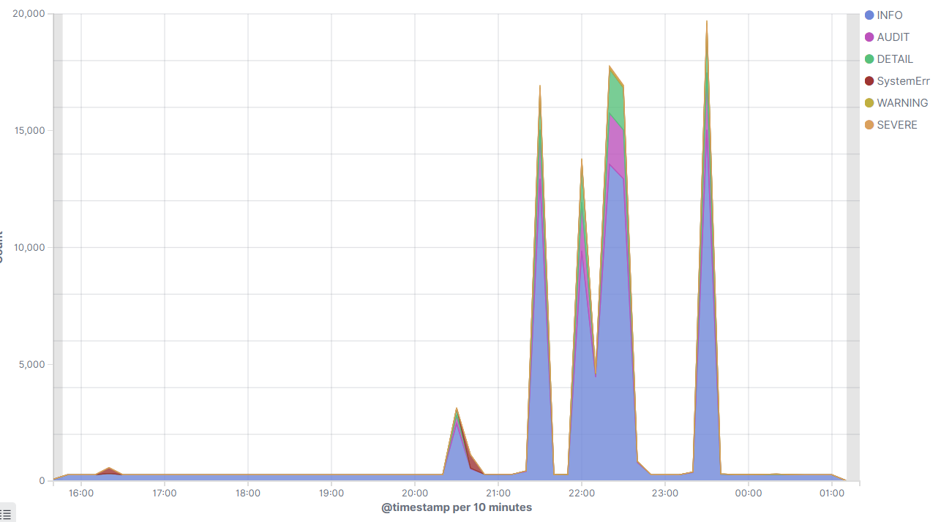
Logging and ElasticSearch
Important performance metrics / insights can also be “harvested” from logging
Logging is often the easiest way to export metrics out of the application
In order to use logging for monitoring and alerting, centralized logging (ElasticSearch) should be used with logging in Json format
Sample metrics:
messages.log: messages by severity and POD
http_access.log: Number of requests, request times, response codes

Slide 16
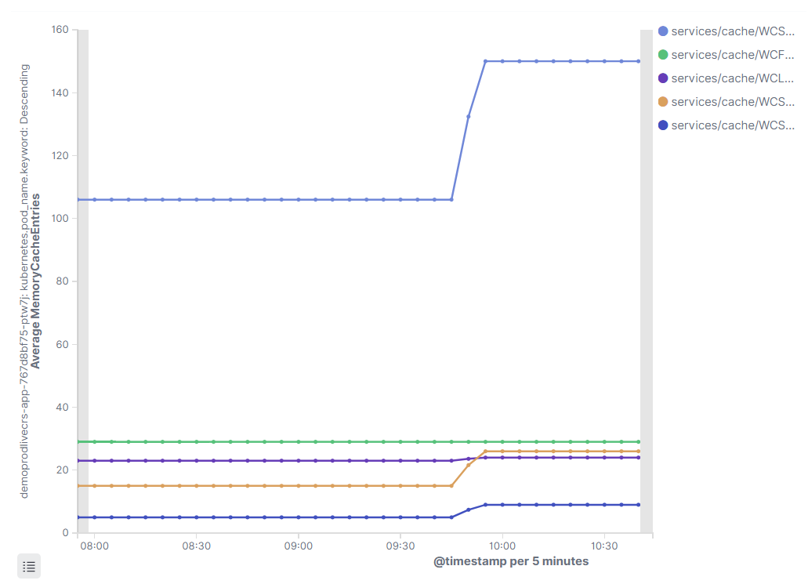
Sample: Dynacache metrics into Elastic
With log entries in Json format, we can take advantage of Elastic’s strong charting and dashboarding capabilities
The following technique relies on a thread to write Dynacache performance metrics at regular intervals {"type":"liberty_message","host":"LP1-US-51830221.PROD.HCLPNP.COM","ibm_userDir":"C:\/dev\/Liberty\/usr\/","ibm_serverName":"dynaTesting","message":"{\"RemoteUpdateNotifications\":0,\"GarbageCollectorInvalidationsFromDisk\":0,\"ObjectsReadFromDisk400K\":0,\"ObjectsDeleteFromDisk40K\":0,\"TemplateBasedInvalidationsFromDisk\":0,\"ExplicitInvalidationsFromDisk\":0,\"ObjectsWriteToDisk400K\":0,\"PushPullTableSize\":0,\"ExplicitInvalidationsRemote\":0,\"ObjectsWriteToDisk40K\":0,\"ObjectsWriteToDisk4000K\":0,\"ObjectsReadFromDisk\":0,\"DependencyIdBasedInvalidationsFromDisk\":0,\"OverflowInvalidationsFromDisk\":0…\":0,\"ObjectsReadFromDisk40K\":0,\"ObjectsDeleteFromDisk4000K\":0,\"PendingRemovalFromDisk\":0,\"ObjectsDeleteFromDisk\":0,\"CacheLruRemoves\":0}","ibm_threadId":"0000005d","ibm_datetime":"2019-11-20T15:50:42.590-0500","module":"monitor","loglevel":"INFO","ibm_methodName":"baseCache","ibm_className":"dynacache_stats","ibm_sequence":"1574283042590_000000000021E","ext_thread":"pool-3-thread-1"}
An Elastic Ingress pipeline can be used to process the log entries and extract the json within the message attribute
{
"processors": [{
"json": {
"if": "ctx.ibm_className == 'dynacache_stats'",
"field": "message",
"add_to_root": true
}
}, {
"remove": {
"if": "ctx.ibm_className == 'dynacache_stats'",
"field": "message"
}
}]
}
Notes:
https://github01.hclpnp.com/commerce-dev/performance-assets/tree/master/PerfMonitor

Slide 17
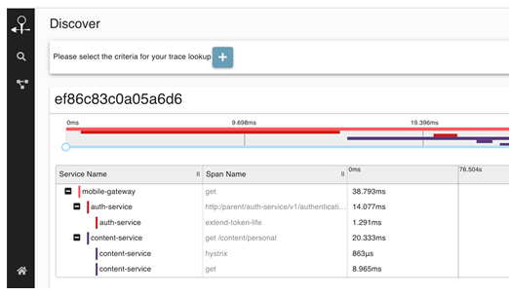
OpenTracing
OpenTracing (aka distributed tracing) allows tracking of a request as it navigates to different microservices
Although more critical with CRS store, it is still relevant with SPA
Tracking is done with a set of standardized headers (X-request-id)
Frameworks such as ZipKin or Jaeger offer UIs for analysis
Example:
New request arrives on Ingress (nginx)
Nginx decides if the request should be traced (only a percentage is traced for performance purposes
Nginx attaches OpenTracing headers on the request (which also specify if tracing is enabled)
When the request reaches a microservice, the microservices is responsible for propagating the headers (otherwise we end up with multiple indifivusla requests)

